Slide 1
Forest Park Southeast, Botanical Heights, Central West End, Medical Campus
Washington University Medical Center

Slide 2
Forest Park Southeast: Summary Notes
20 total crimes in August 2019
11.1% change compared to August 2018 (18 total crimes)
1 crime(s) against persons in August 2019
-75.0% change compared to August 2018 (4 crimes against persons)
165 total crimes in 2019
25.0% change compared to this time in 2018 (132 total crimes)
27 crime(s) against persons in 2019
-20.6% change compared to this time in 2018 (34 crimes against persons)

Slide 3
Forest Park Southeast: Year to Year Comparison
Part 1 Crimes | Jan | Feb | Mar | Apr | May | Jun | Jul | Aug | Sep | Oct | Nov | Dec | Total
Aggravated Assault | 1 | 2 | 0 | 3 | 7 | 4 | 4 | 3 | 1 | 7 | 0 | 3 | 35
Arson | 0 | 0 | 1 | 0 | 0 | 0 | 0 | 0 | 0 | 0 | 0 | 0 | 1
Burgalry | 0 | 1 | 1 | 3 | 0 | 1 | 1 | 1 | 0 | 1 | 0 | 0 | 9
Homicide | 1 | 0 | 0 | 0 | 0 | 0 | 0 | 0 | 0 | 0 | 0 | 0 | 1
Larceny | 5 | 5 | 5 | 8 | 20 | 4 | 14 | 11 | 15 | 7 | 10 | 3 | 107
Motor Vehicle Theft | 2 | 1 | 2 | 0 | 3 | 3 | 3 | 2 | 2 | 2 | 2 | 2 | 24
Robbery | 0 | 0 | 1 | 1 | 1 | 4 | 2 | 1 | 0 | 2 | 1 | 2 | 15
Total | 9 | 9 | 10 | 15 | 31 | 16 | 24 | 18 | 18 | 19 | 13 | 10 | 192
Part 1 Crimes | Jan | Feb | Mar | Apr | May | Jun | Jul | Aug | Total
Aggravated Assault | 0 | 3 | 1 | 2 | 2 | 4 | 2 | 0 | 14
Arson | 0 | 0 | 1 | 0 | 0 | 1 | 0 | 0 | 2
Burgalry | 0 | 0 | 1 | 1 | 0 | 0 | 3 | 1 | 6
Larceny | 7 | 10 | 15 | 12 | 9 | 21 | 16 | 17 | 107
Motor Vehicle Theft | 3 | 6 | 1 | 2 | 0 | 4 | 6 | 1 | 23
Robbery | 1 | 0 | 1 | 1 | 2 | 5 | 2 | 1 | 13
Total | 11 | 19 | 20 | 18 | 13 | 35 | 29 | 20 | 165

Slide 4
Forest Park Southeast: Summary Tables
Part 1 Crimes | Number of Crimes
Burgalry | 1
Larceny | 17
Motor Vehicle Theft | 1
Robbery | 1
Total | 20
Day of the Week | Number of Crimes
Sun | 1
Mon | 1
Tue | 4
Wed | 3
Thu | 6
Fri | 2
Sat | 3
Total | 20
Crimes Against Persons | Number of Crimes
FALSE | 19
TRUE | 1
Total | 20
Time of Day | Number of Crimes
Day | 15
Night | 5
Total | 20

Slide 5
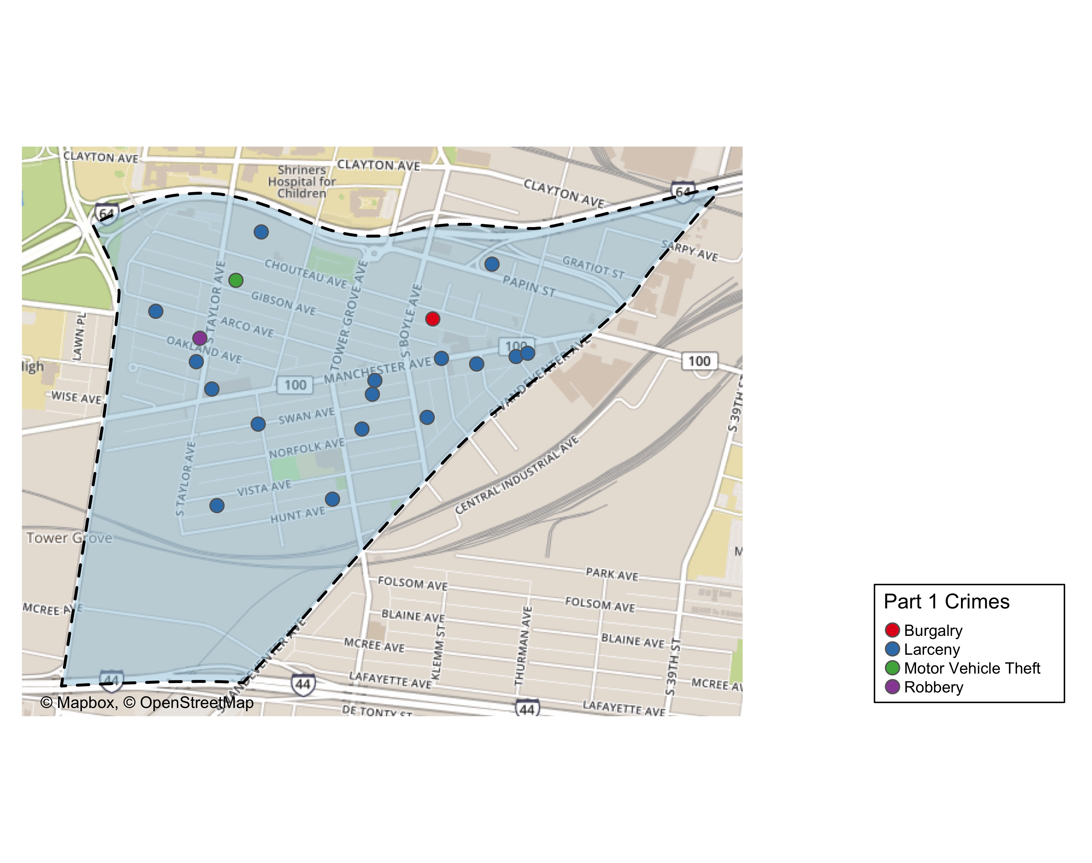
Forest Park Southeast: Total Crime Map

Slide 6
Botanical Heights: Summary Notes
4 total crimes in August 2019
-77.8% change compared to August 2018 (18 total crimes)
1 crime(s) against persons in August 2019
0% change compared to August 2018 (1 crimes against persons)
53 total crimes in 2019
-32.1% change compared to this time in 2018 (78 total crimes)
9 crime(s) against persons in 2019
28.6% change compared to this time in 2018 (7 crimes against persons)

Slide 7
Botanical Heights: Year to Year Comparison
Part 1 Crimes | Jan | Feb | Mar | Apr | May | Jun | Jul | Aug | Sep | Oct | Nov | Dec | Total
Aggravated Assault | 0 | 0 | 1 | 1 | 1 | 2 | 0 | 0 | 0 | 0 | 1 | 1 | 7
Burgalry | 1 | 2 | 0 | 1 | 3 | 2 | 0 | 8 | 3 | 4 | 2 | 5 | 31
Larceny | 14 | 1 | 6 | 0 | 4 | 7 | 5 | 8 | 6 | 4 | 4 | 2 | 61
Motor Vehicle Theft | 4 | 0 | 1 | 0 | 1 | 0 | 2 | 1 | 0 | 0 | 2 | 0 | 11
Robbery | 1 | 0 | 0 | 0 | 0 | 0 | 0 | 1 | 0 | 0 | 0 | 0 | 2
Total | 20 | 3 | 8 | 2 | 9 | 11 | 7 | 18 | 9 | 8 | 9 | 8 | 112
Part 1 Crimes | Jan | Feb | Mar | Apr | May | Jun | Jul | Aug | Total
Aggravated Assault | 0 | 0 | 0 | 0 | 4 | 0 | 0 | 1 | 5
Burgalry | 2 | 0 | 0 | 2 | 0 | 0 | 1 | 1 | 6
Larceny | 2 | 3 | 6 | 3 | 3 | 3 | 9 | 1 | 30
Motor Vehicle Theft | 1 | 1 | 3 | 0 | 1 | 1 | 0 | 1 | 8
Robbery | 0 | 2 | 0 | 0 | 1 | 1 | 0 | 0 | 4
Total | 5 | 6 | 9 | 5 | 9 | 5 | 10 | 4 | 53

Slide 8
Botanical Heights: Summary Tables
Part 1 Crimes | Number of Crimes
Aggravated Assault | 1
Burgalry | 1
Larceny | 1
Motor Vehicle Theft | 1
Total | 4
Day of the Week | Number of Crimes
Mon | 1
Wed | 1
Sat | 2
Total | 4
Crimes Against Persons | Number of Crimes
FALSE | 3
TRUE | 1
Total | 4
Time of Day | Number of Crimes
Day | 4
Total | 4

Slide 9
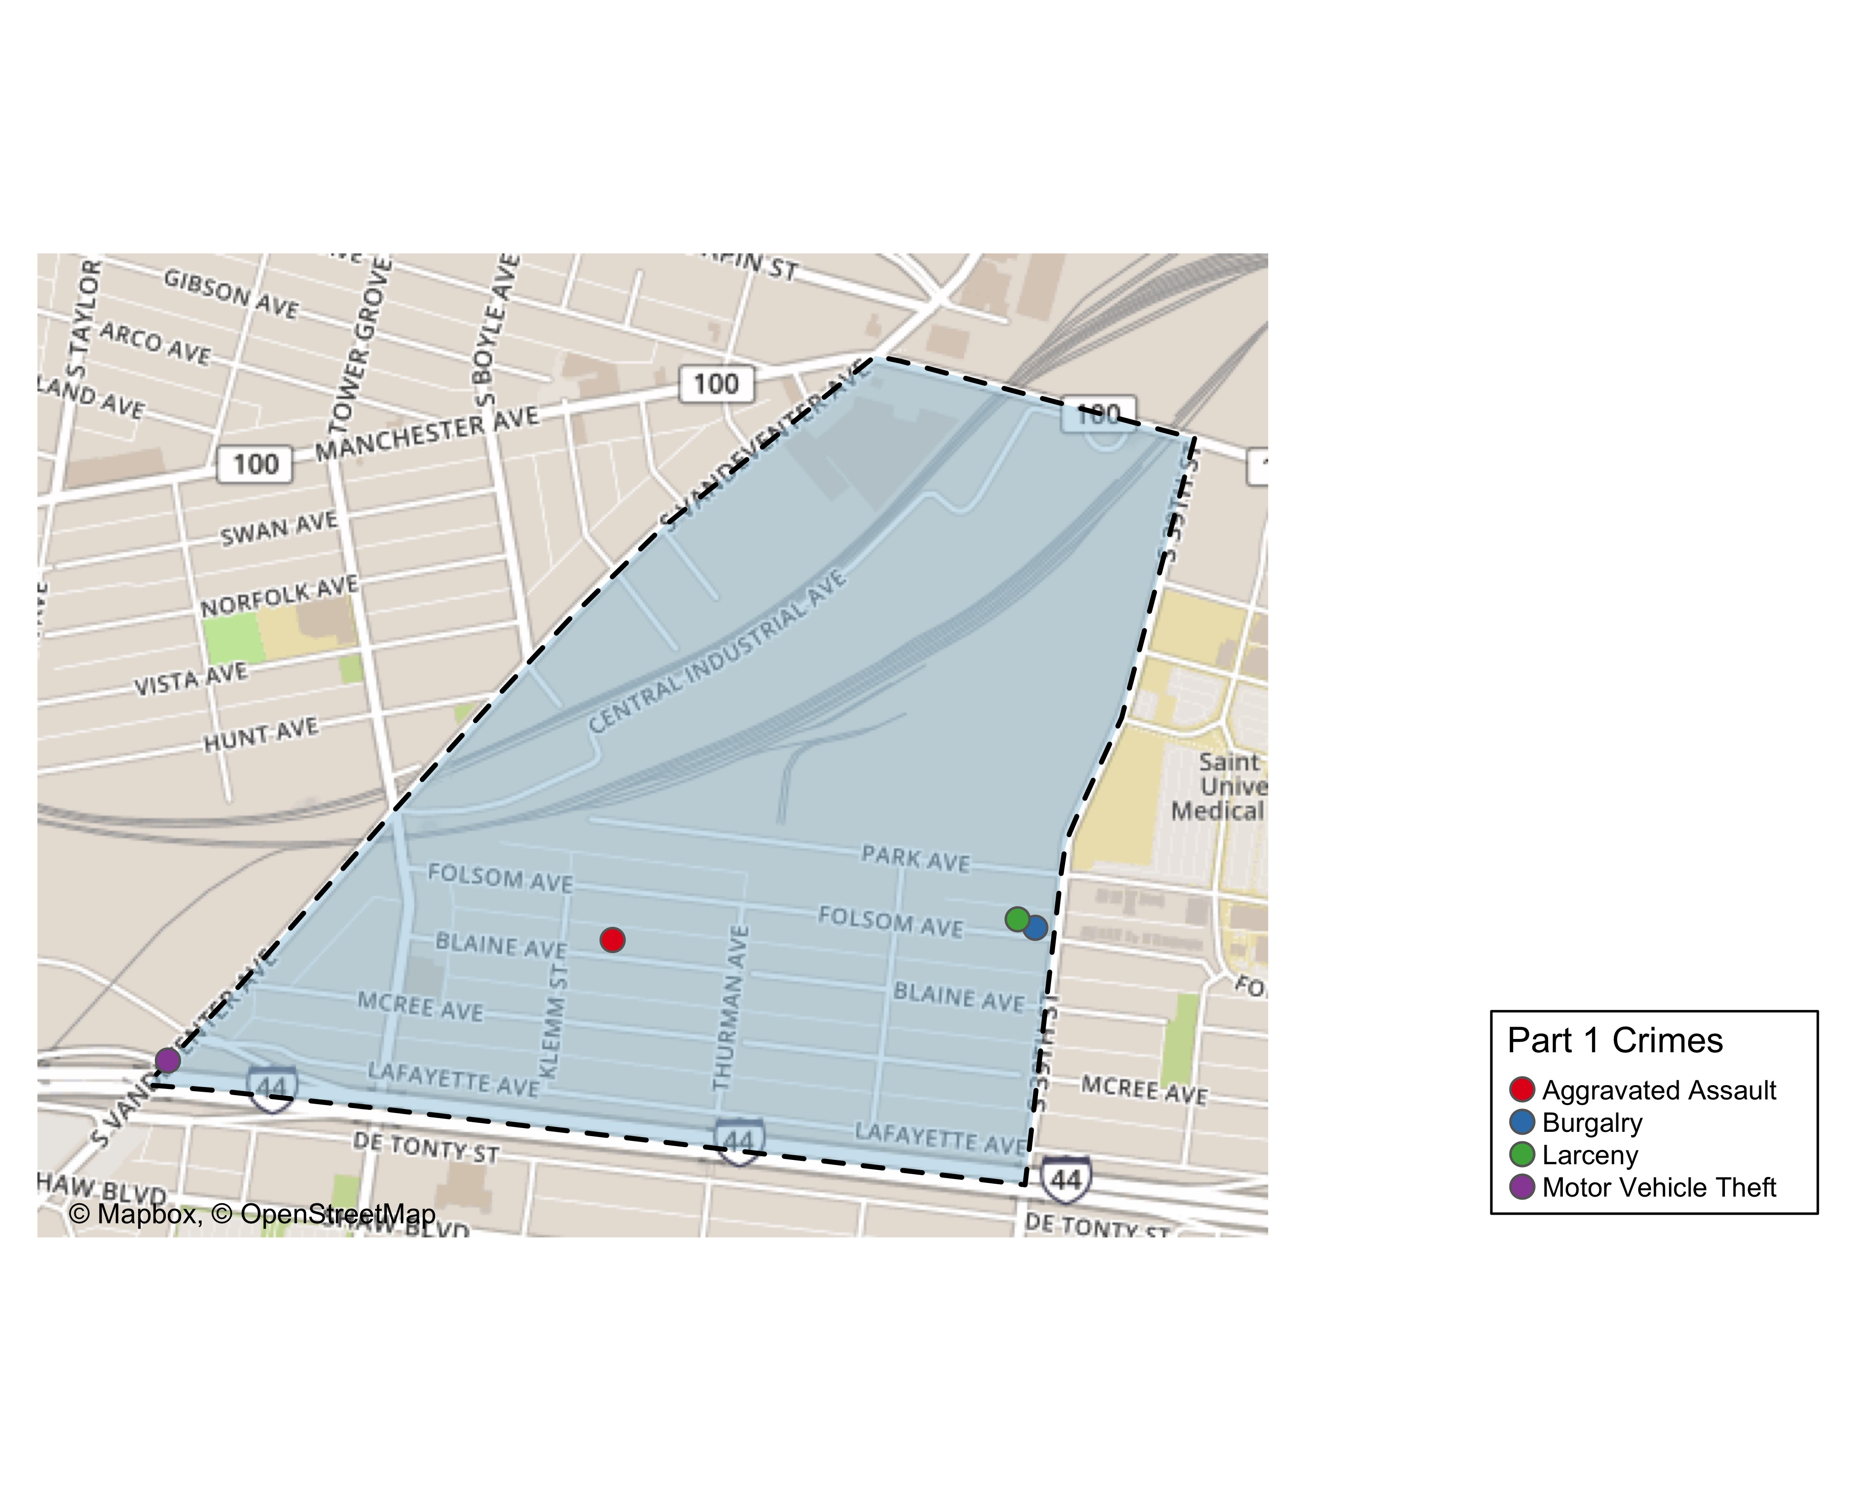
Botanical Heights: Total Crime Map

Slide 10
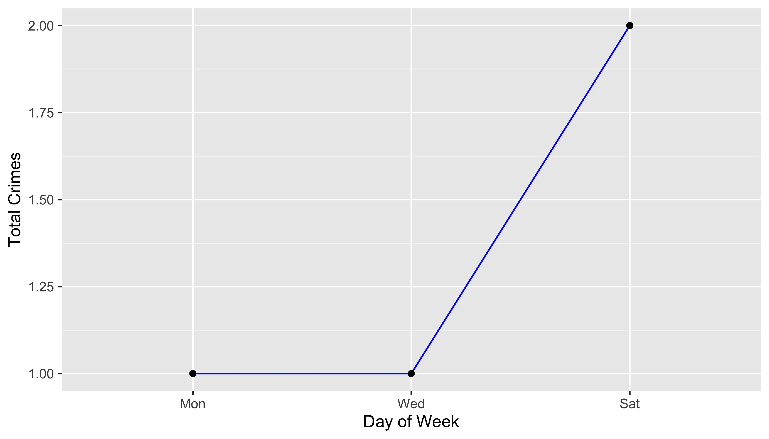
Botanical Heights: Crime by Days of the Week

Slide 11
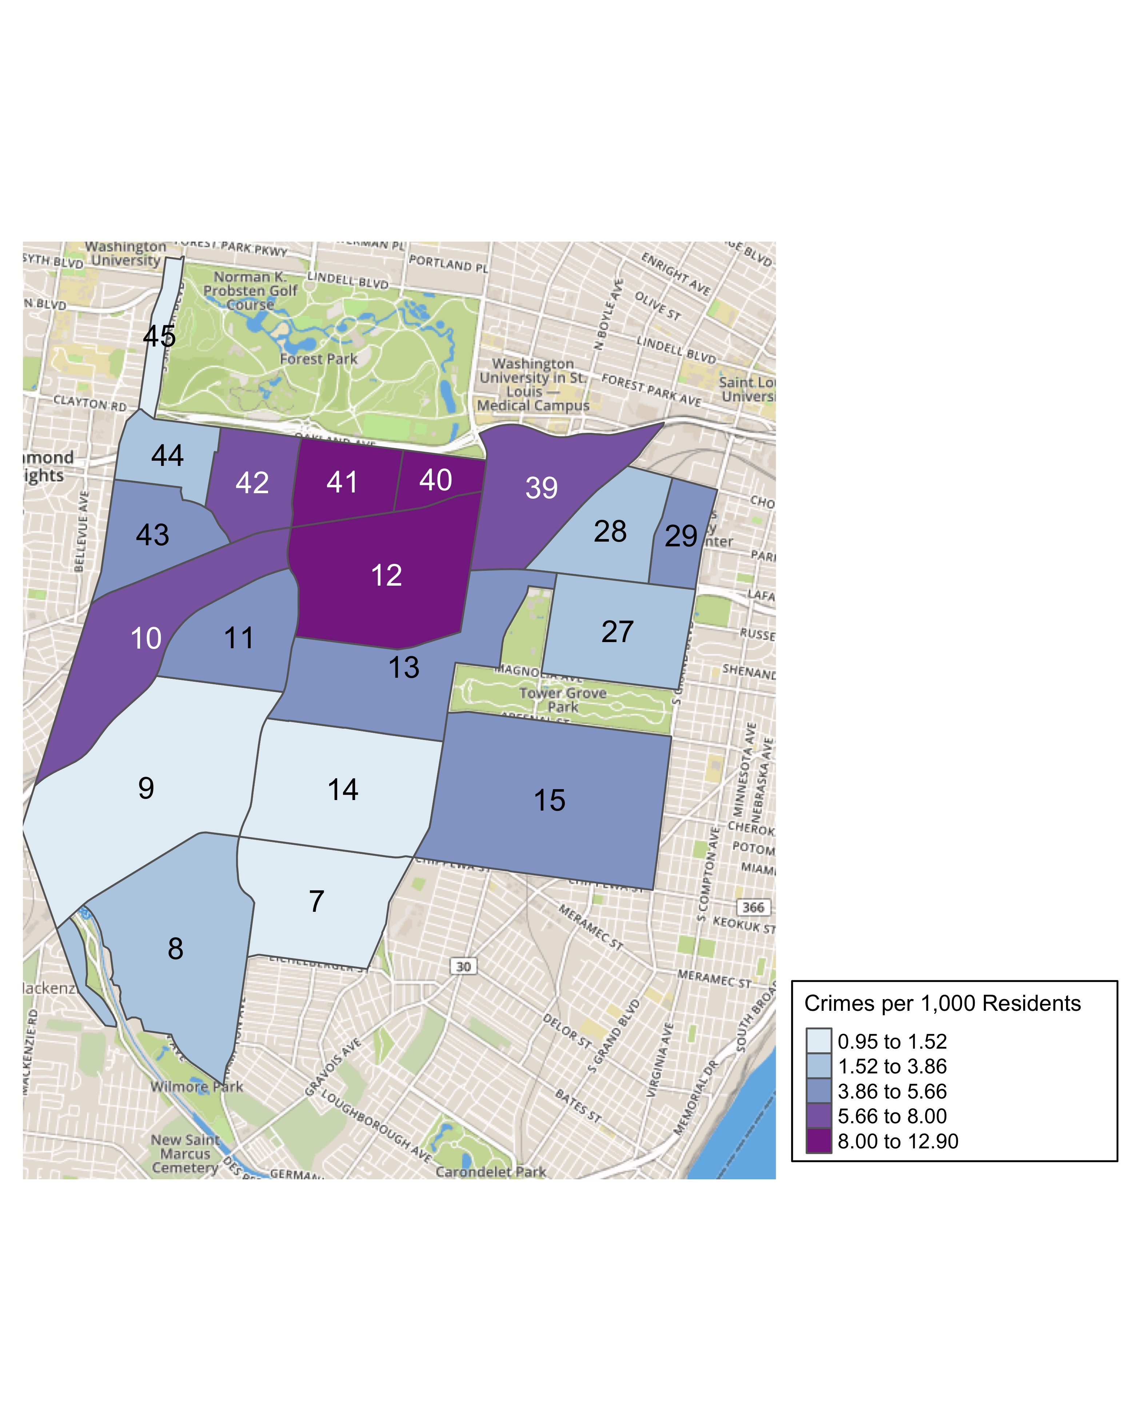
District 2: Crime Rates Map

Slide 12
District 2: Density Map Explanation
There are 23 neighborhoods in District 2. The South Hampton neighborhood is split between District 2 and District 1.
The minimum number of crimes in one neighborhood was 1 (Wydown Skinker)
The maximum number of crimes in one neighborhood was 72 (Tower Grove South)
The mean number of crimes in one neighborhood was 15.95
The minimum rate of crimes in one neighborhood was 0.95 (Wydown Skinker)
The maximum rate of crimes in one neighborhood was 12.9 (Cheltenham)
The mean rate of crimes in one neighborhood was 5.28

Slide 13
Summary Notes: Central West End
121 total crimes in August 2019
0% change compared to August 2018 (121 total crimes)
18 crime(s) against persons in August 2019
38.5% change compared to August 2018 (13 crimes against persons)
759 total crimes in 2019
-9.64% change compared to this time in 2018 (840 total crimes)
100 crime(s) against persons in 2019
16.3% change compared to this time in 2018 (86 crimes against persons)

Slide 14
Central West End: Year to Year Comparison
Part 1 Crimes | Jan | Feb | Mar | Apr | May | Jun | Jul | Aug | Sep | Oct | Nov | Dec | Total
Aggravated Assault | 7 | 0 | 1 | 7 | 7 | 11 | 6 | 3 | 7 | 4 | 4 | 10 | 67
Burgalry | 3 | 5 | 6 | 6 | 7 | 12 | 10 | 16 | 8 | 7 | 11 | 2 | 93
Homicide | 1 | 0 | 0 | 0 | 0 | 0 | 0 | 0 | 0 | 0 | 0 | 0 | 1
Larceny | 95 | 61 | 48 | 52 | 68 | 89 | 130 | 88 | 73 | 82 | 60 | 49 | 895
Motor Vehicle Theft | 8 | 5 | 7 | 10 | 11 | 5 | 7 | 4 | 11 | 11 | 7 | 8 | 94
Robbery | 2 | 2 | 8 | 10 | 1 | 8 | 3 | 10 | 5 | 8 | 5 | 6 | 68
Total | 116 | 73 | 70 | 85 | 94 | 125 | 156 | 121 | 104 | 112 | 87 | 75 | 1,218
Part 1 Crimes | Jan | Feb | Mar | Apr | May | Jun | Jul | Aug | Total
Aggravated Assault | 9 | 4 | 10 | 2 | 8 | 13 | 4 | 10 | 60
Arson | 0 | 0 | 1 | 0 | 0 | 0 | 0 | 0 | 1
Burgalry | 3 | 5 | 5 | 9 | 13 | 8 | 13 | 16 | 72
Larceny | 45 | 66 | 65 | 65 | 71 | 55 | 75 | 76 | 518
Motor Vehicle Theft | 11 | 7 | 3 | 11 | 12 | 9 | 4 | 11 | 68
Robbery | 5 | 5 | 2 | 6 | 7 | 3 | 4 | 8 | 40
Total | 73 | 87 | 86 | 93 | 111 | 88 | 100 | 121 | 759

Slide 15
Central West End: Summary Tables
Part 1 Crimes | Number of Crimes
Aggravated Assault | 10
Burgalry | 16
Larceny | 76
Motor Vehicle Theft | 11
Robbery | 8
Total | 121
Day of the Week | Number of Crimes
Sun | 14
Mon | 18
Tue | 10
Wed | 19
Thu | 21
Fri | 25
Sat | 14
Total | 121
Crimes Against Persons | Number of Crimes
FALSE | 103
TRUE | 18
Total | 121
Time of Day | Number of Crimes
Day | 102
Night | 19
Total | 121

Slide 16
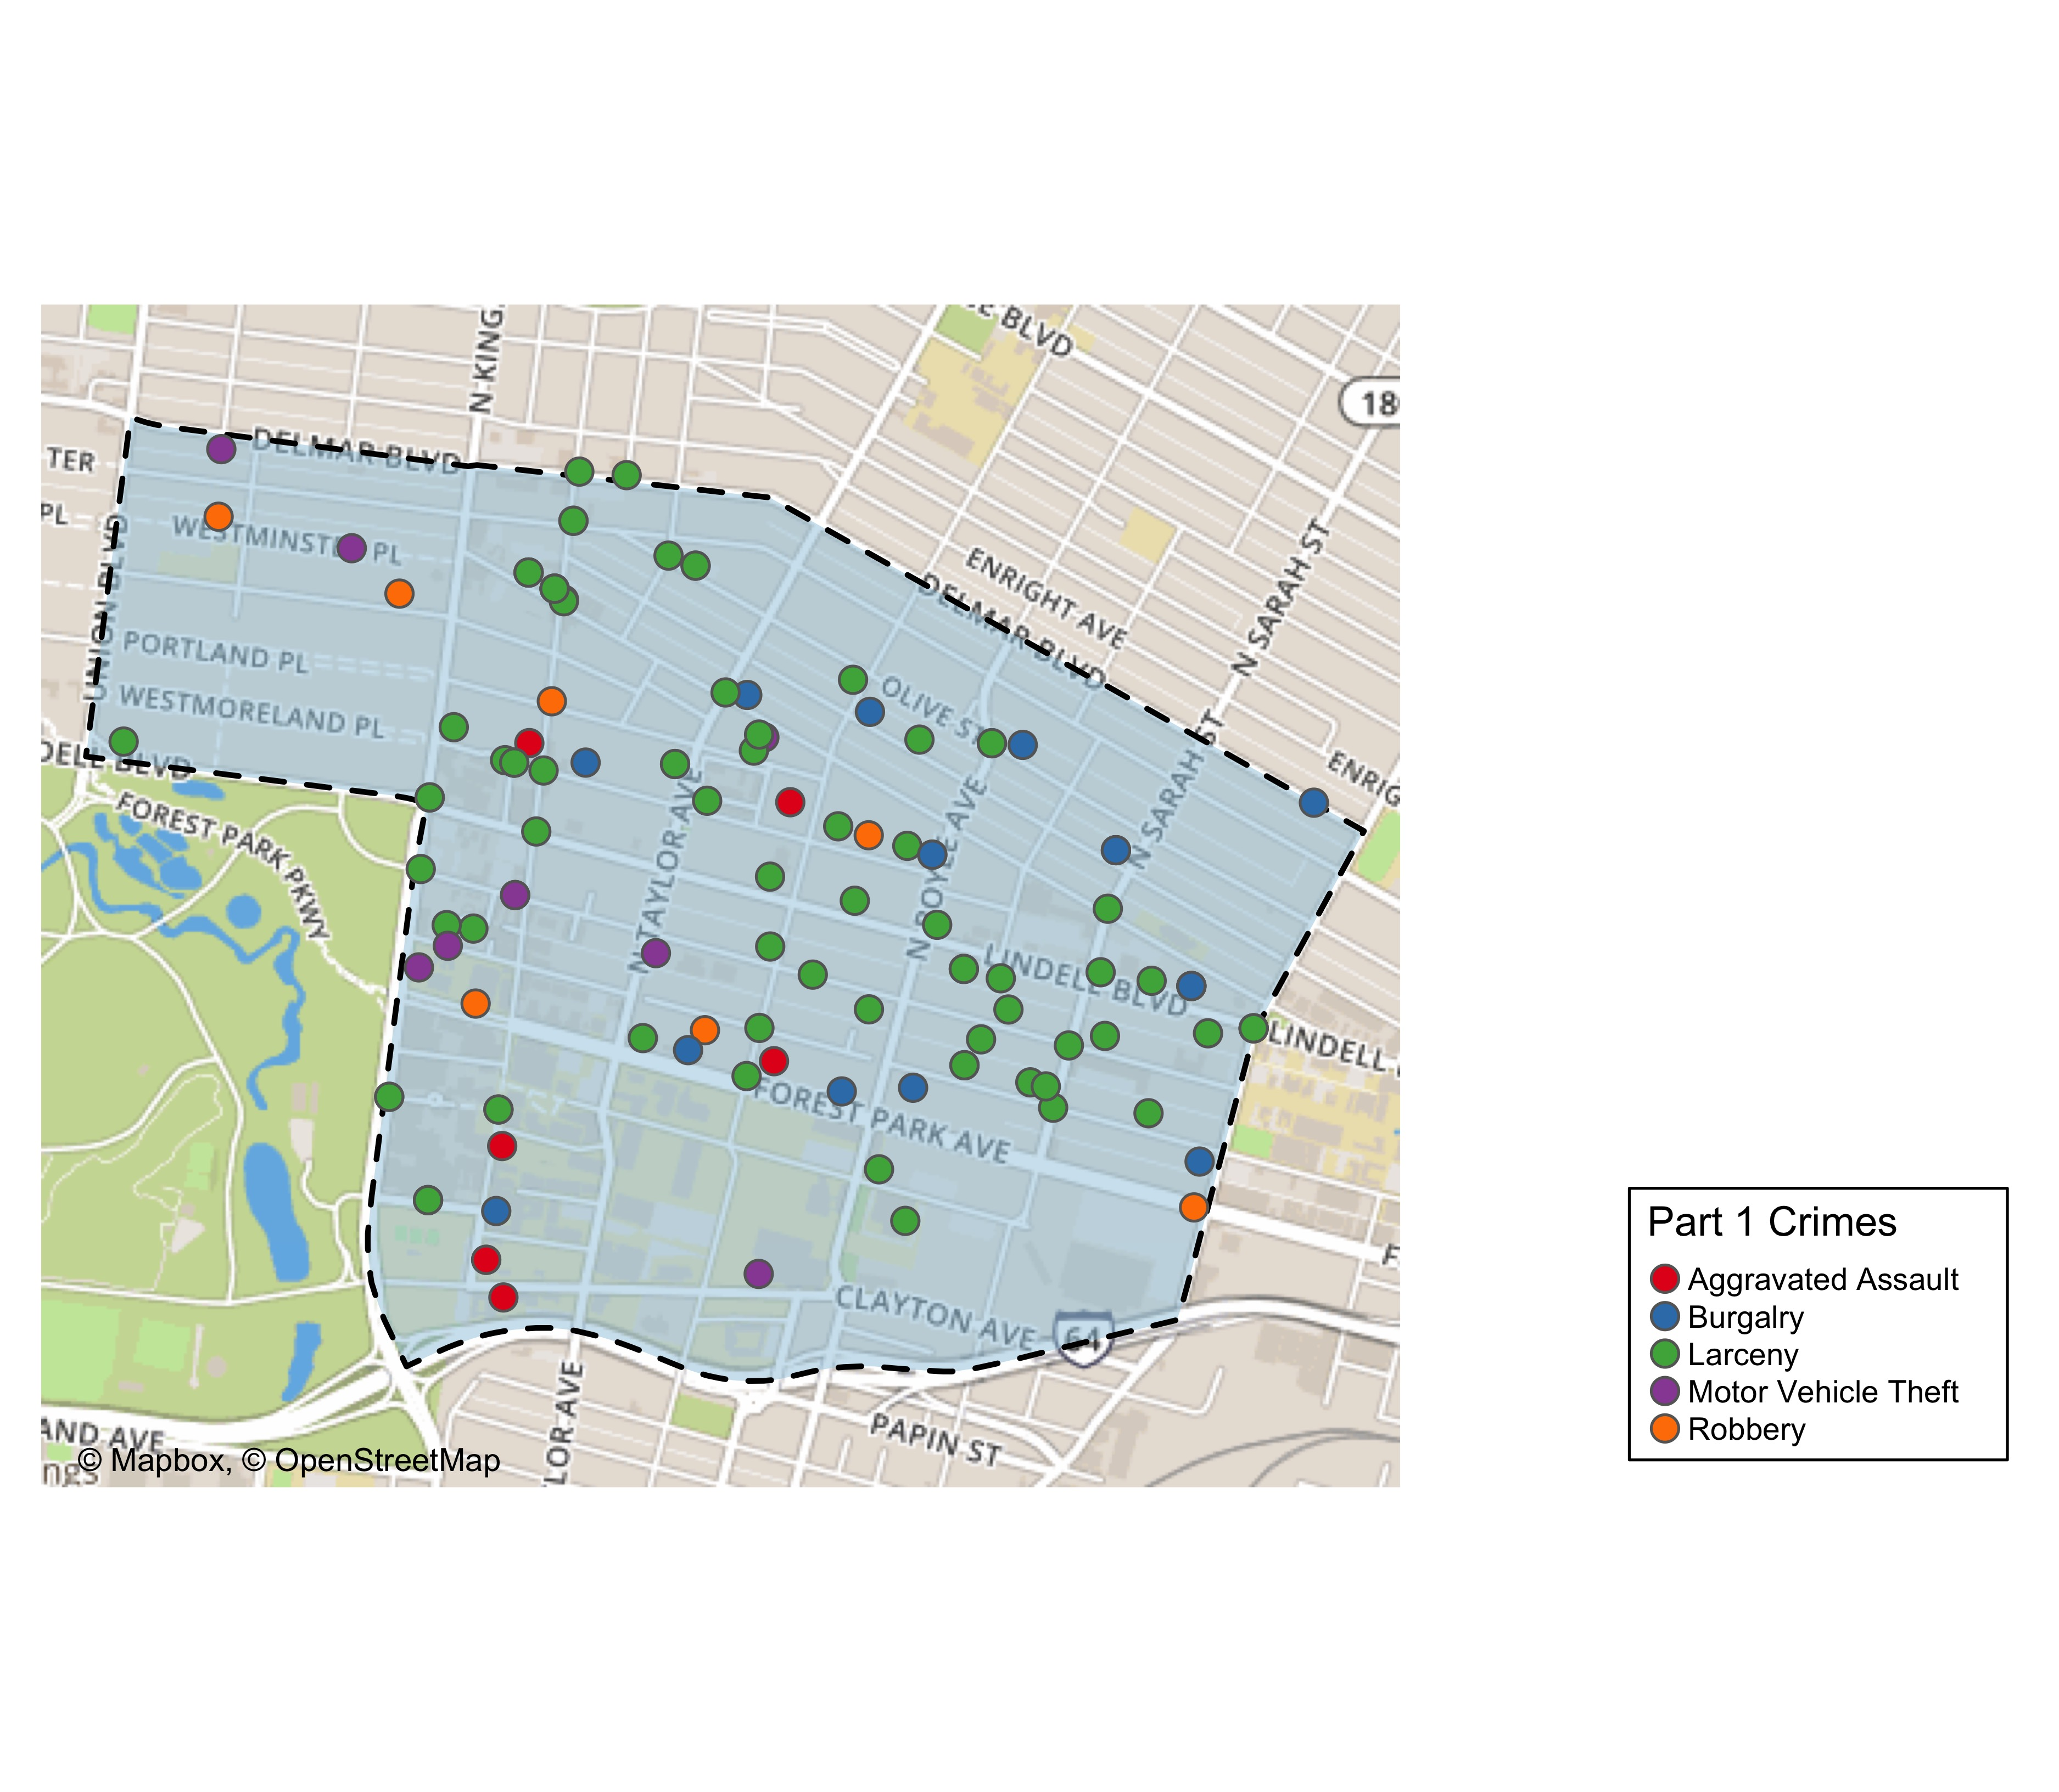
Central West End: Total Crime Map

Slide 17
Washington University Medical Campus: Summary Notes
12 total crimes in August 2019
200% change compared to August 2018 (4 total crimes)
6 crime(s) against persons in August 2019
Inf change compared to August 2018 (0 crimes against persons)
81 total crimes in 2019
20.9% change compared to this time in 2018 (67 total crimes)
16 crime(s) against persons in 2019
129% change compared to this time in 2018 (7 crimes against persons)

Slide 18
Washington University Medical Campus: Year to Year Comparison
Part 1 Crimes | Jan | Feb | Mar | Apr | May | Jun | Jul | Aug | Sep | Oct | Nov | Dec | Total
Aggravated Assault | 4 | 0 | 1 | 0 | 0 | 1 | 0 | 0 | 0 | 0 | 0 | 1 | 7
Homicide | 1 | 0 | 0 | 0 | 0 | 0 | 0 | 0 | 0 | 0 | 0 | 0 | 1
Larceny | 13 | 8 | 9 | 11 | 3 | 3 | 2 | 4 | 8 | 5 | 3 | 8 | 77
Motor Vehicle Theft | 1 | 0 | 1 | 3 | 1 | 0 | 0 | 0 | 1 | 3 | 3 | 0 | 13
Robbery | 0 | 0 | 0 | 1 | 0 | 0 | 0 | 0 | 1 | 0 | 1 | 0 | 3
Total | 19 | 8 | 11 | 15 | 4 | 4 | 2 | 4 | 10 | 8 | 7 | 9 | 101
Part 1 Crimes | Jan | Feb | Mar | Apr | May | Jun | Jul | Aug | Total
Aggravated Assault | 4 | 1 | 1 | 0 | 0 | 2 | 0 | 5 | 13
Burgalry | 0 | 0 | 0 | 0 | 0 | 0 | 0 | 1 | 1
Larceny | 7 | 8 | 6 | 9 | 9 | 6 | 8 | 4 | 57
Motor Vehicle Theft | 2 | 0 | 1 | 2 | 1 | 0 | 0 | 1 | 7
Robbery | 0 | 0 | 0 | 1 | 0 | 1 | 0 | 1 | 3
Total | 13 | 9 | 8 | 12 | 10 | 9 | 8 | 12 | 81

Slide 19
Washington University Medical Campus: Summary Tables
Part 1 Crimes | Number of Crimes
Aggravated Assault | 5
Burgalry | 1
Larceny | 4
Motor Vehicle Theft | 1
Robbery | 1
Total | 12
Time of Day | Number of Crimes
Day | 9
Night | 3
Total | 12
Type of Larceny | Number of Crimes
Bicycle | 1
From Building | 2
Motor Vehicle Parts | 1
Total | 4
Monetary Value | Number of Crimes
$500 - $24,999 | 2
Under $500 | 2
Total | 4

Slide 20
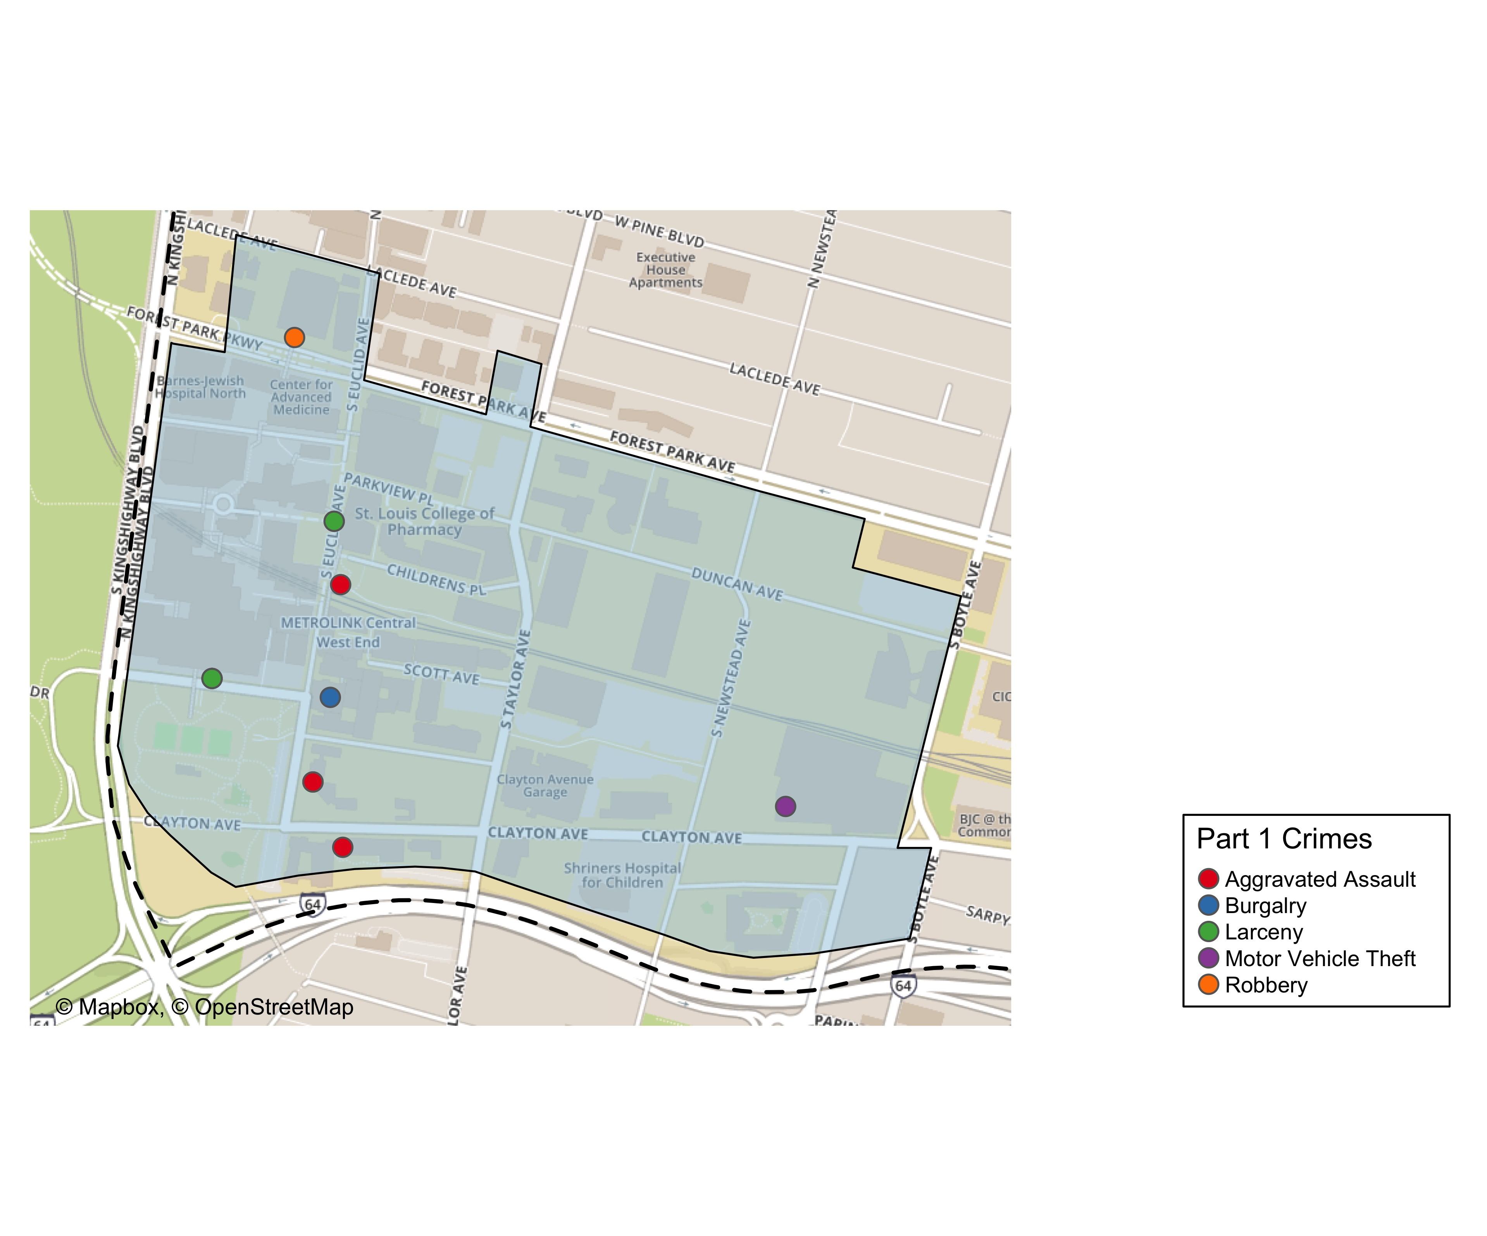
Washington University Medical Center: Total Crime Map

Slide 21
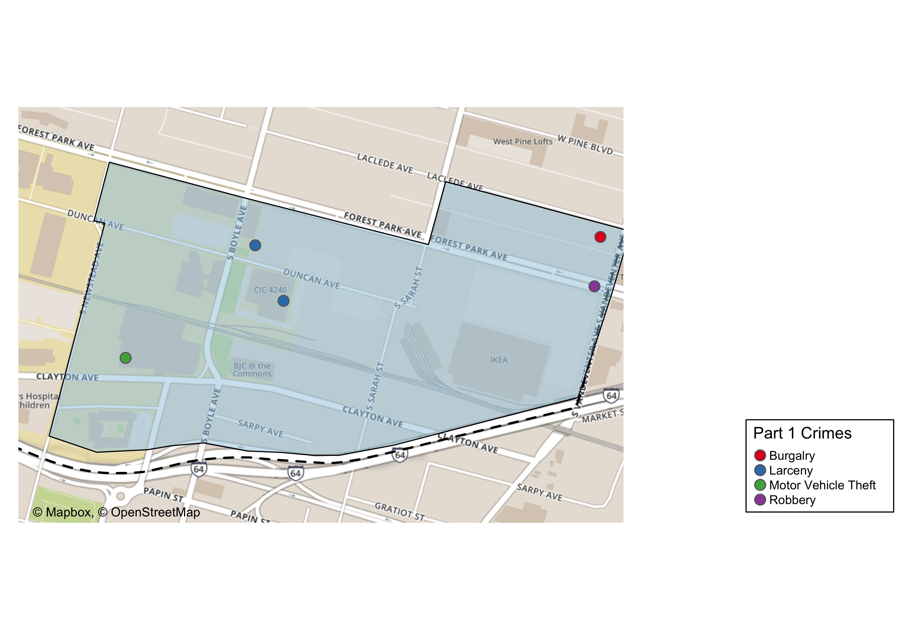
Cortex: Total Crime Map

Slide 22
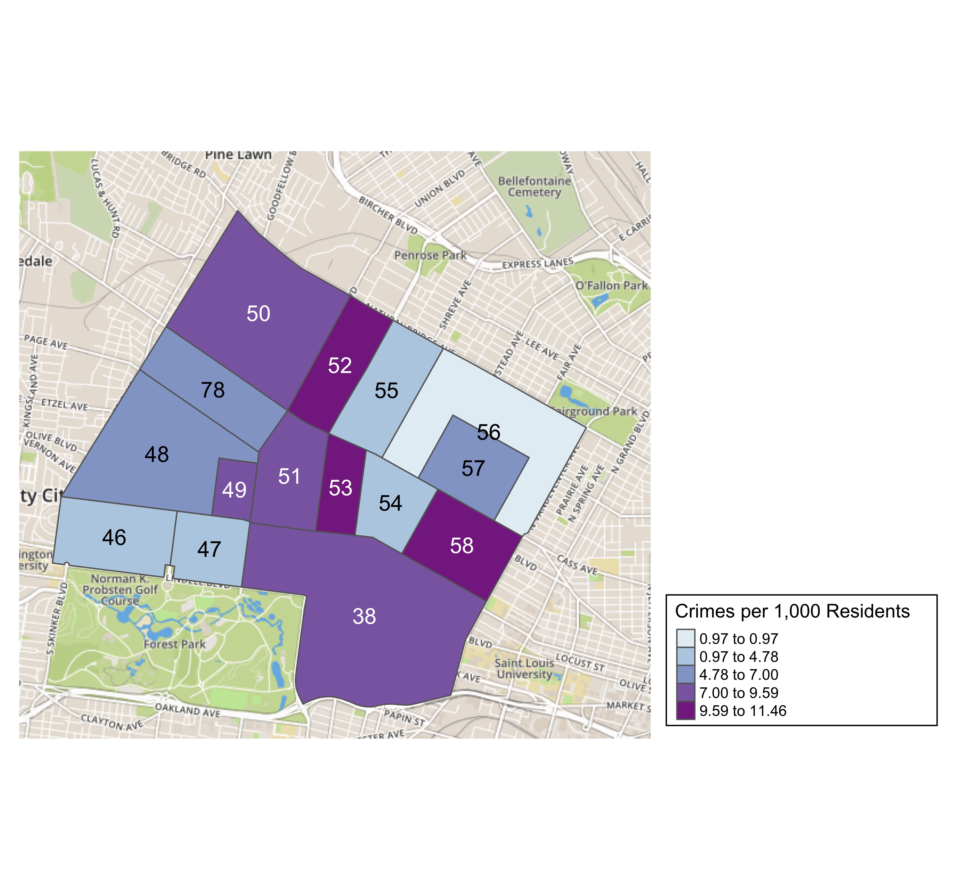
District 5: Crime Rates Map

Slide 23
District 5: Density Map Explanation
There are 15 neighborhoods in District 5.
The minimum number of crimes in one neighborhood was 6 (Greater Ville)
The maximum number of crimes in one neighborhood was 121 (Central West End)
The mean number of crimes in one neighborhood was 27.27
The minimum rate of crimes in one neighborhood was 0.97 (Greater Ville)
The maximum rate of crimes in one neighborhood was 11.46 (Fountain Park)
The mean rate of crimes in one neighborhood was 7.02

Slide 24
Forest Park Southeast: Neighborhood Detail
Appendix 1

Slide 25
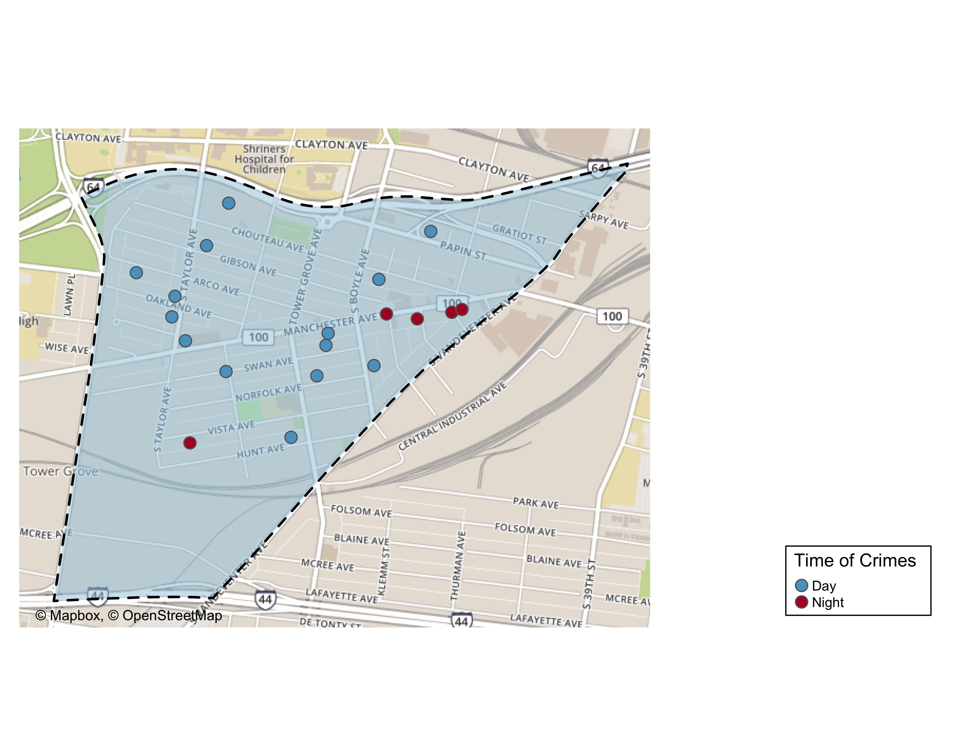
Forest Park Southeast: Time of Crimes Map

Slide 26
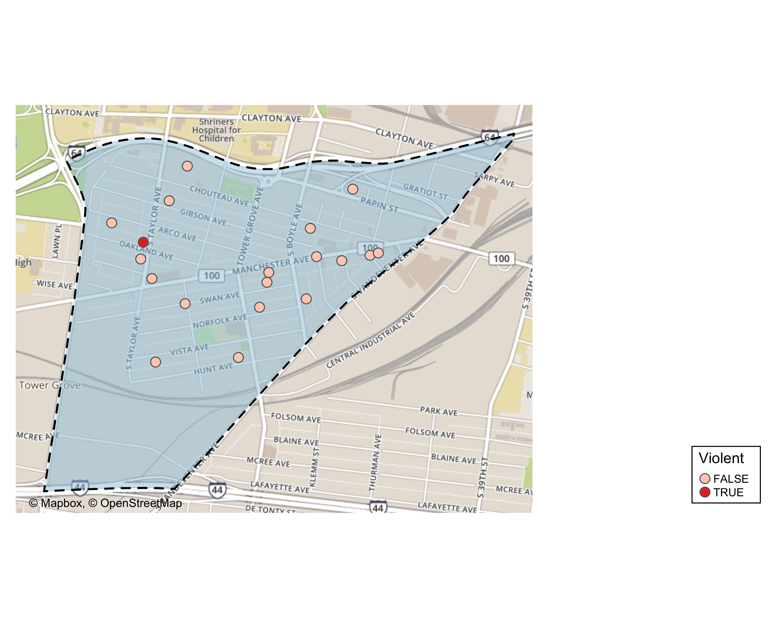
Forest Park Southeast: Violent Crime Map

Slide 27
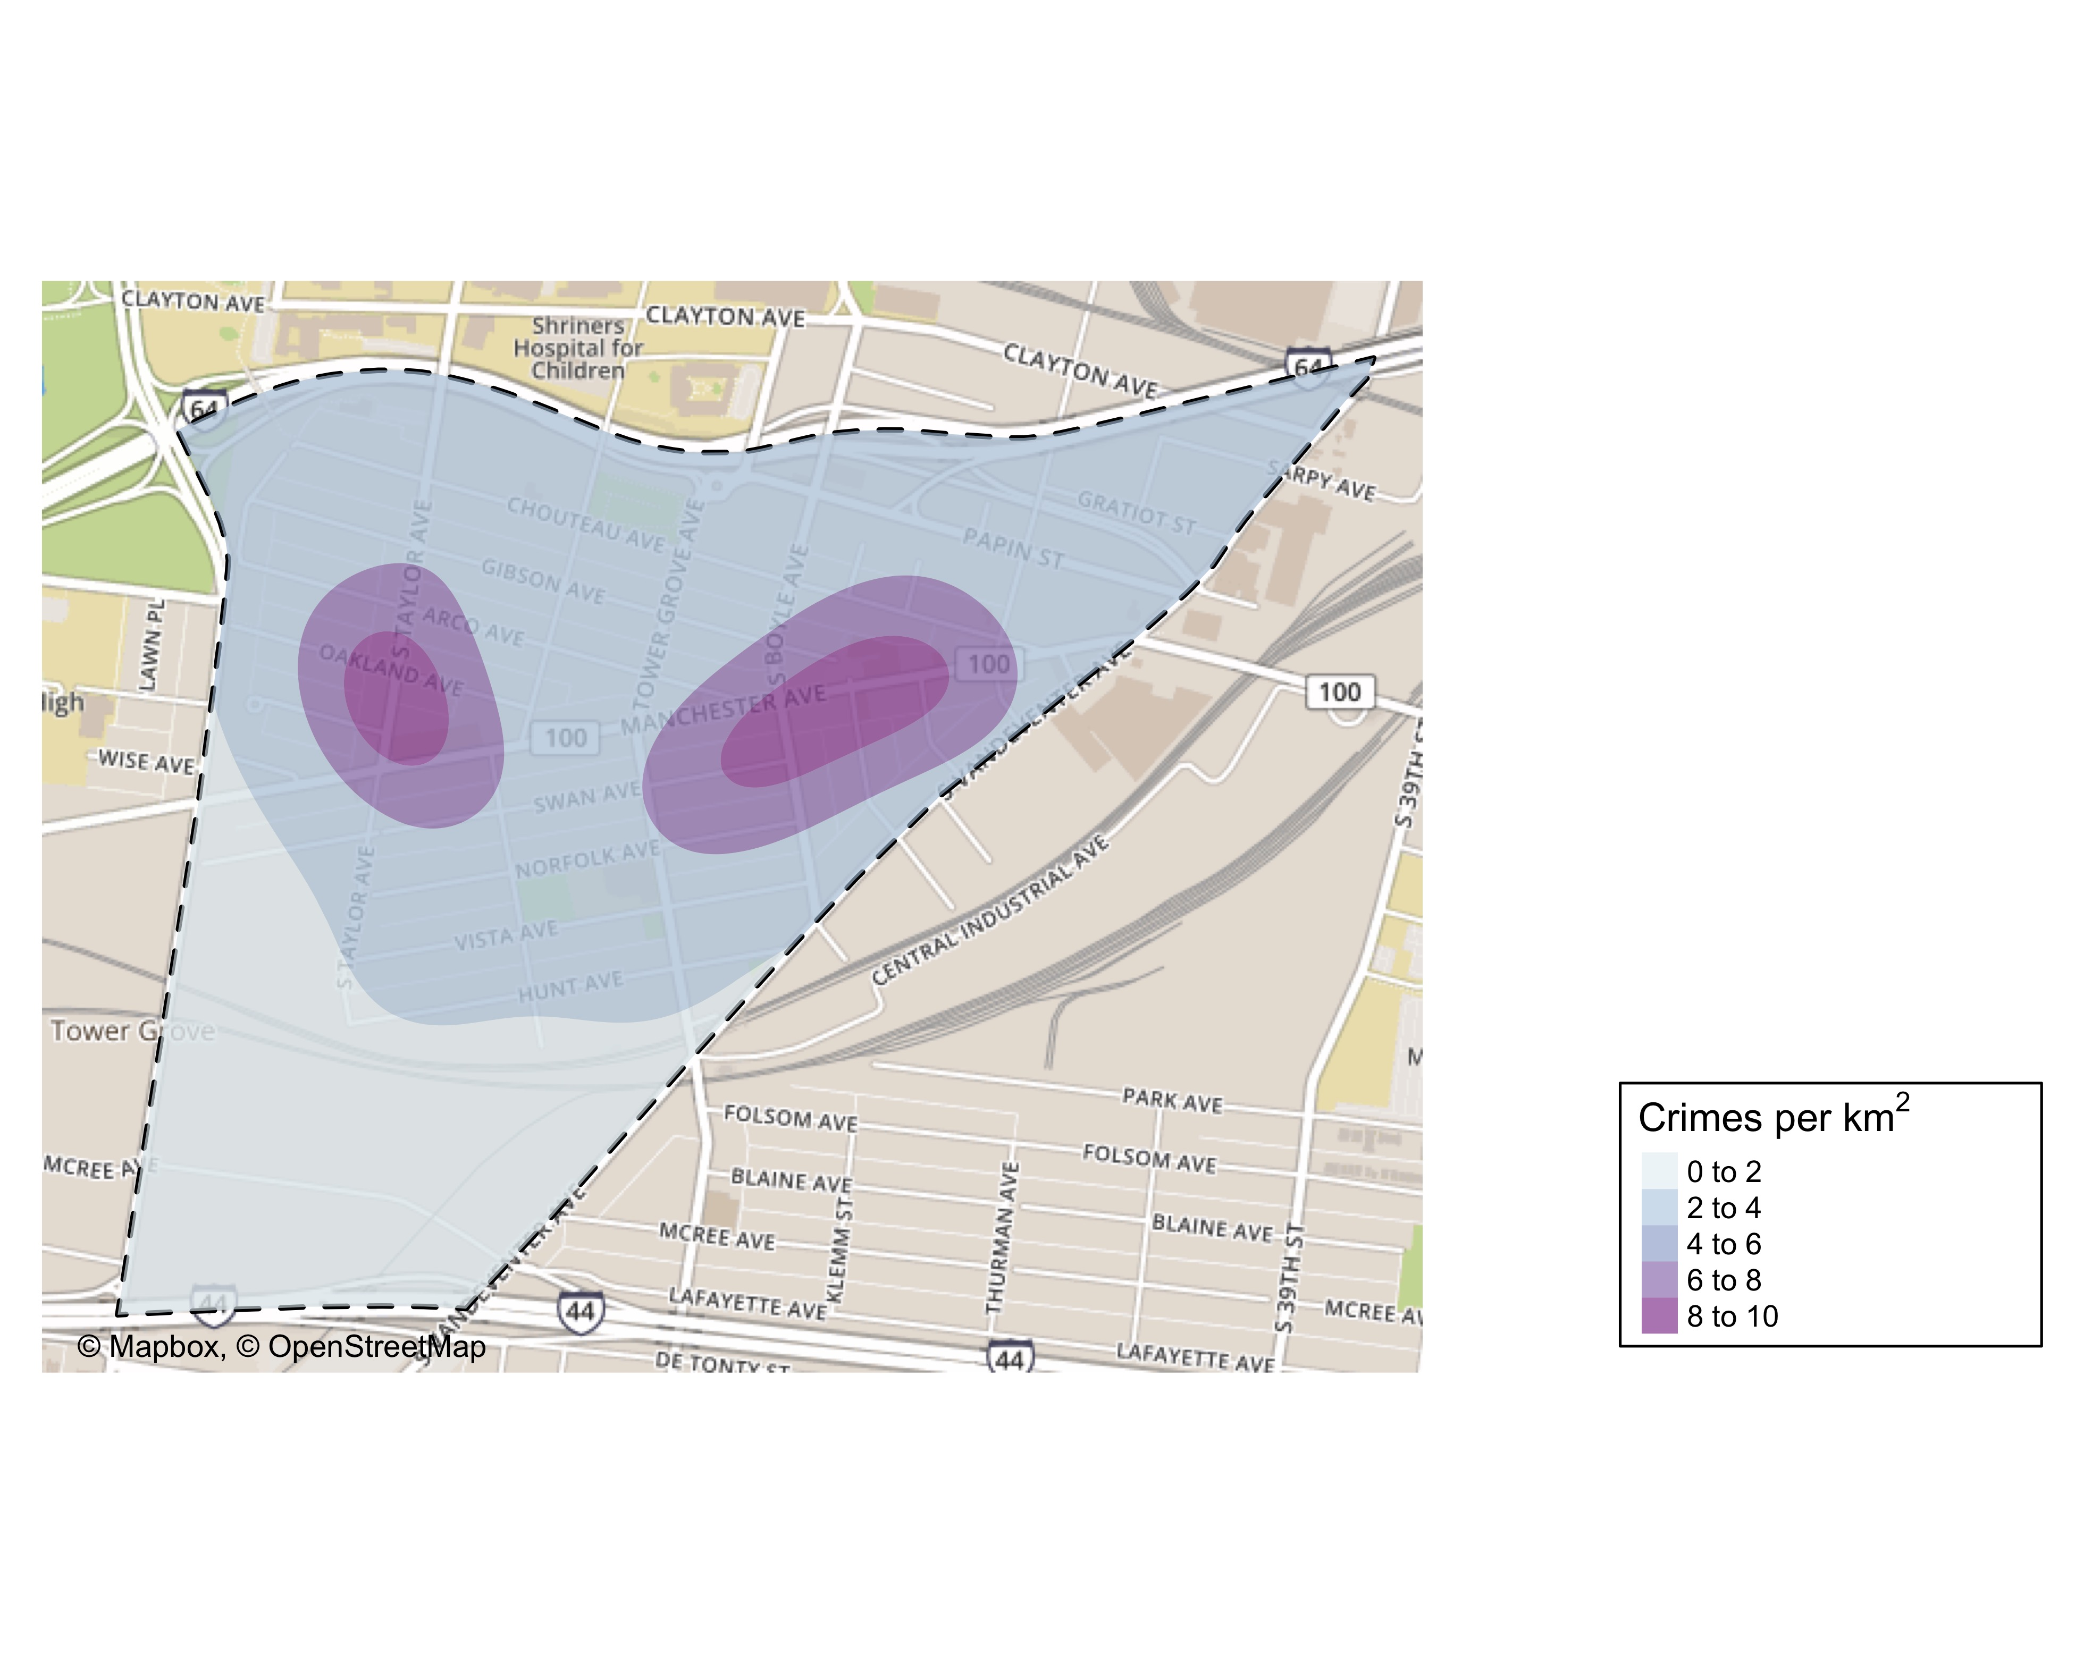
Forest Park Southeast: Crime Density Map

Slide 28
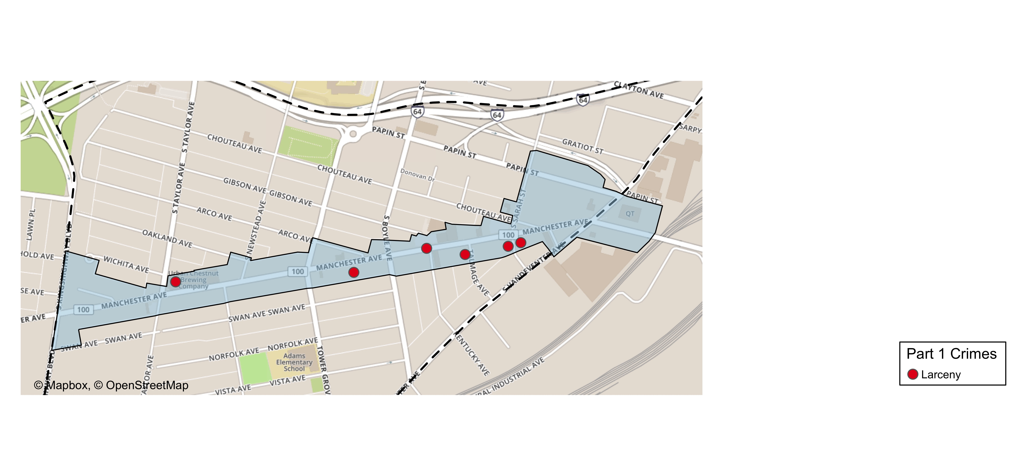
Grove Community Improvement District: Total Crime Map

Slide 29
Forest Park Southeast: Larceny Breakdown
Day of the Week | Number of Crimes
Sun | 1
Mon | 1
Tue | 3
Wed | 2
Thu | 6
Fri | 2
Sat | 2
Total | 17
Time of Day | Number of Crimes
Day | 12
Night | 5
Total | 17
Type of Larceny | Number of Crimes
All Other | 2
Bicycle | 1
From Building | 2
From Motor Vehicle | 8
From Person | 2
Motor Vehicle Parts | 1
Shoplifting | 1
Total | 17
Monetary | Number of Crimes
$500 - $24,999 | 6
Under $500 | 11
Total | 17

Slide 30
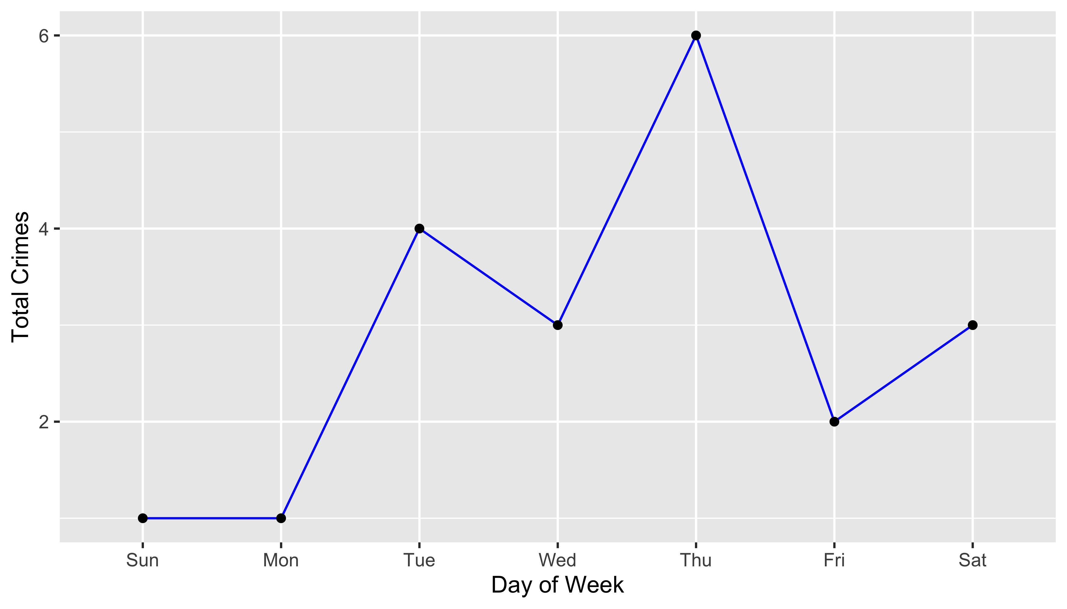
Forest Park Southeast: Total Crimes by Days of the Week

Slide 31
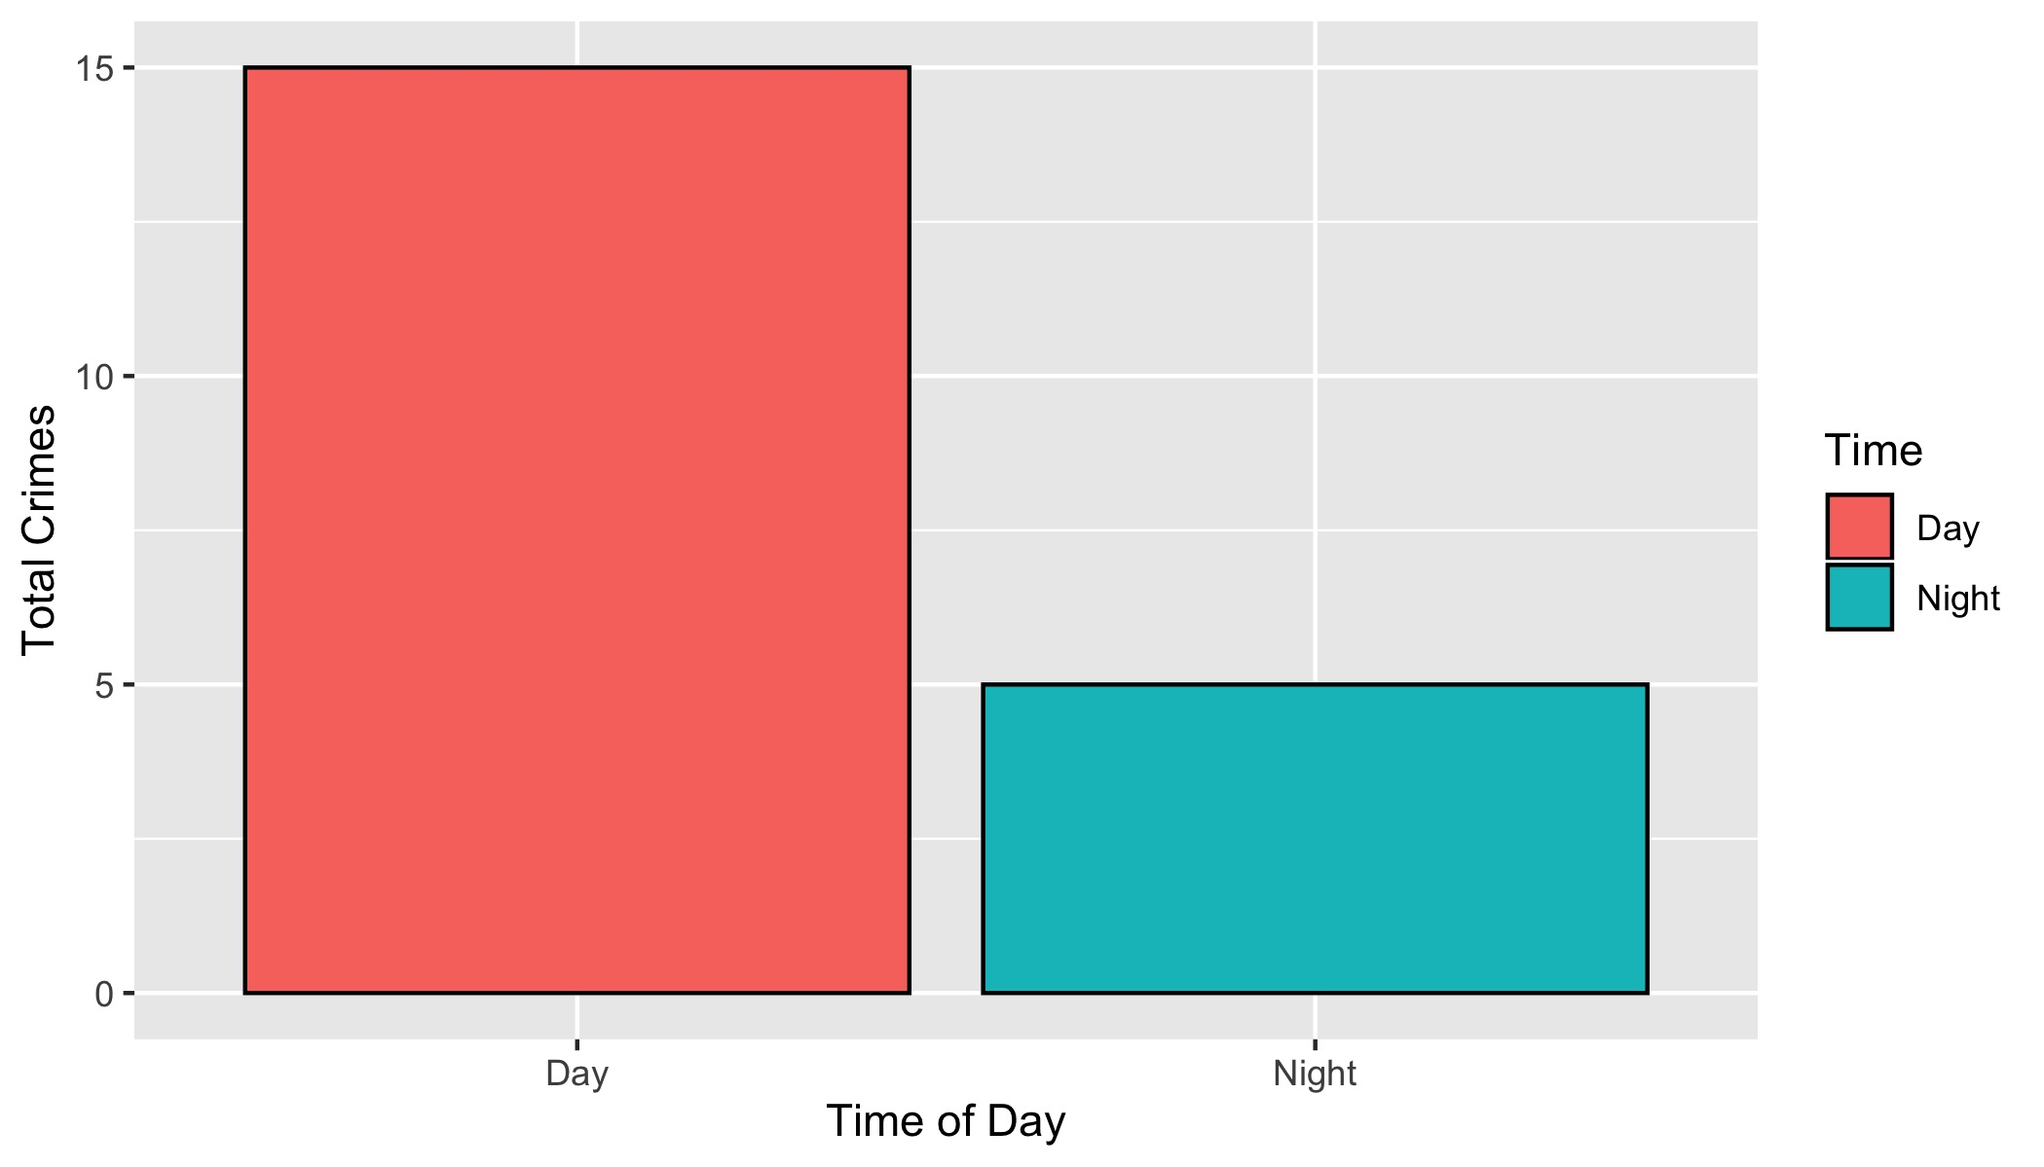
Forest Park Southeast: Crimes by Time of Day

Slide 32
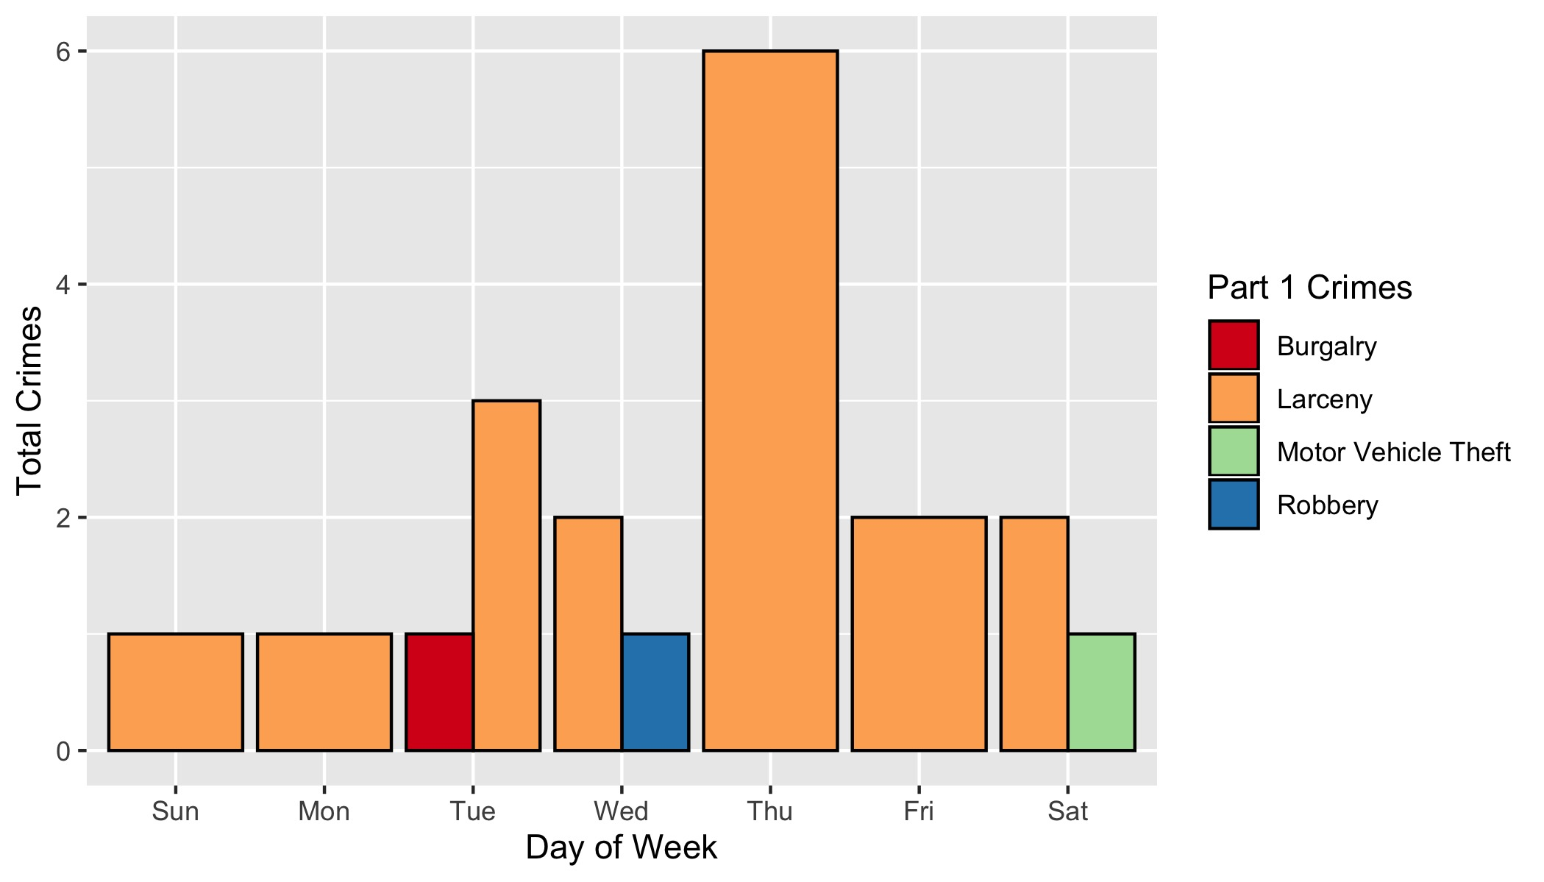
Forest Park Southeast: Crimes by Day & Category

Slide 33
Central West End: Neighborhood Detail
Appendix 2

Slide 34
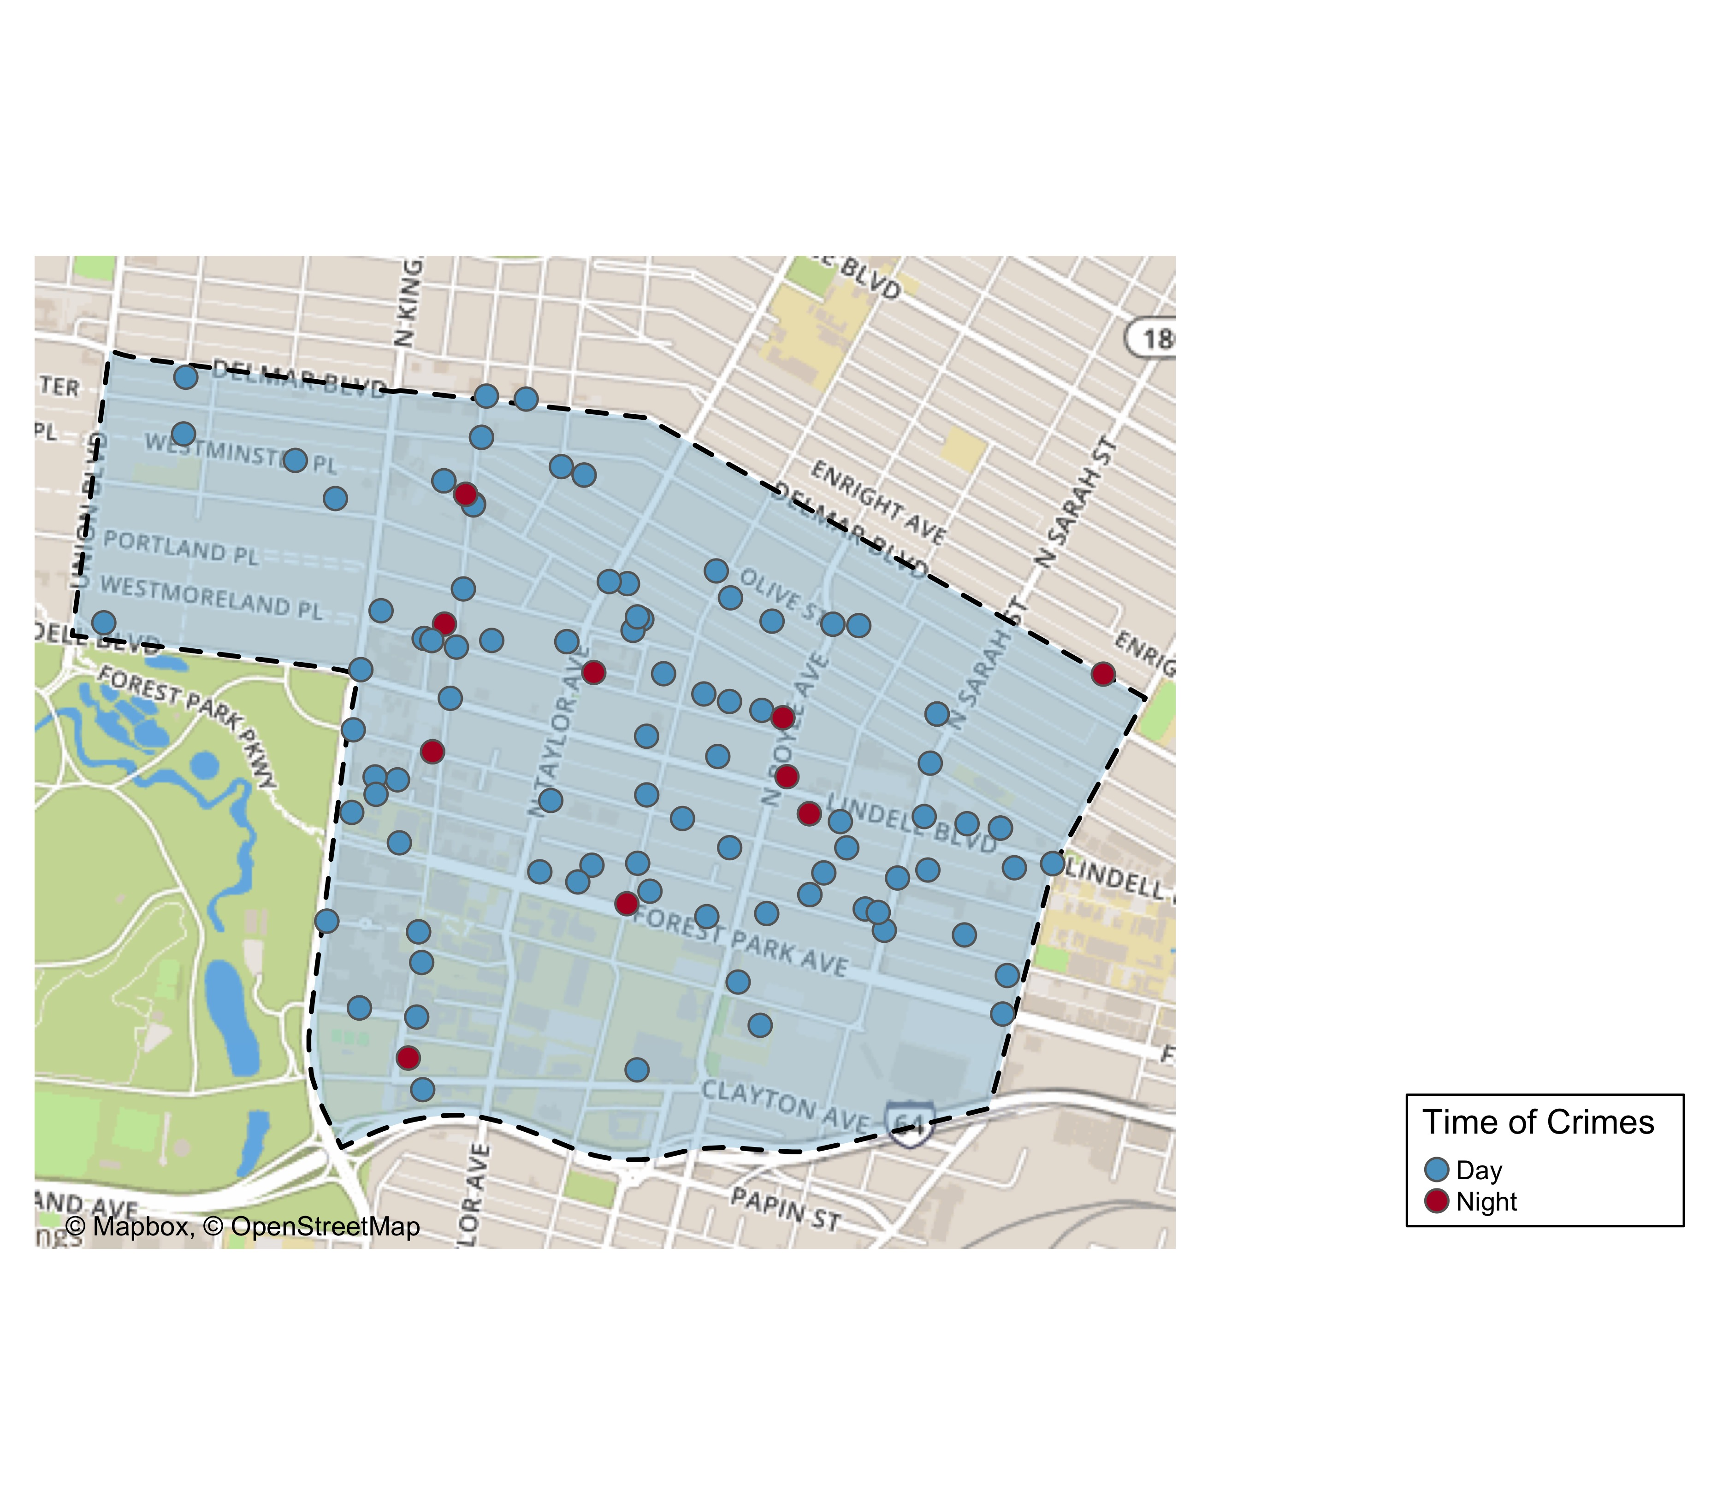
Central West End: Time of Crimes Map

Slide 35
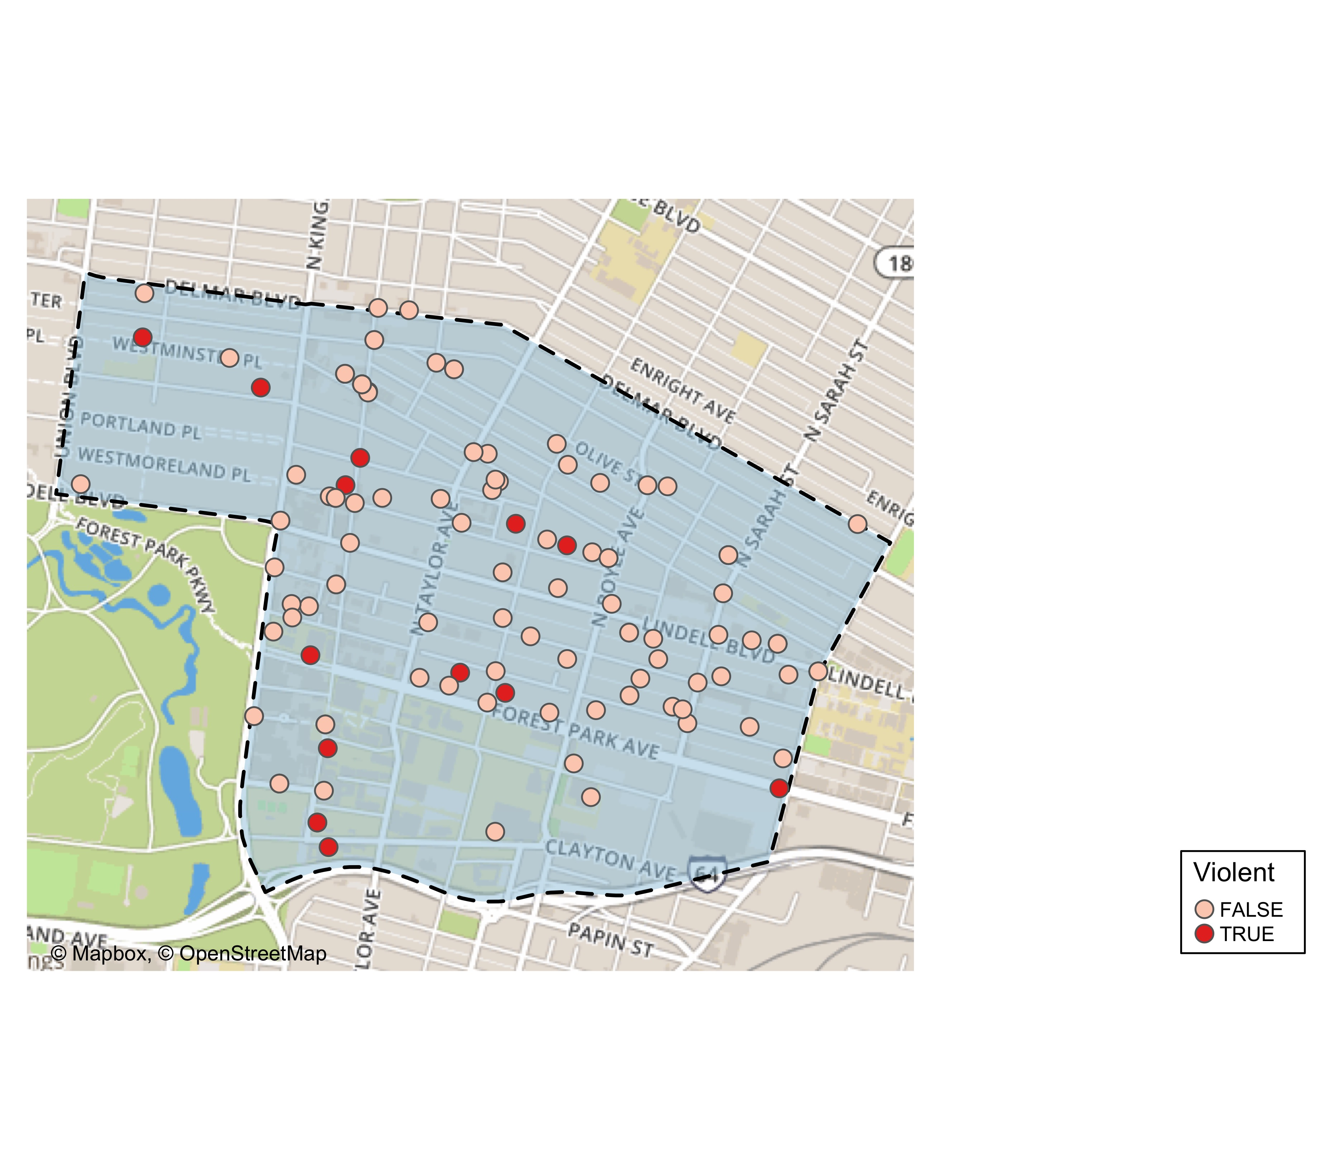
Central West End: Violent Crime Map

Slide 36
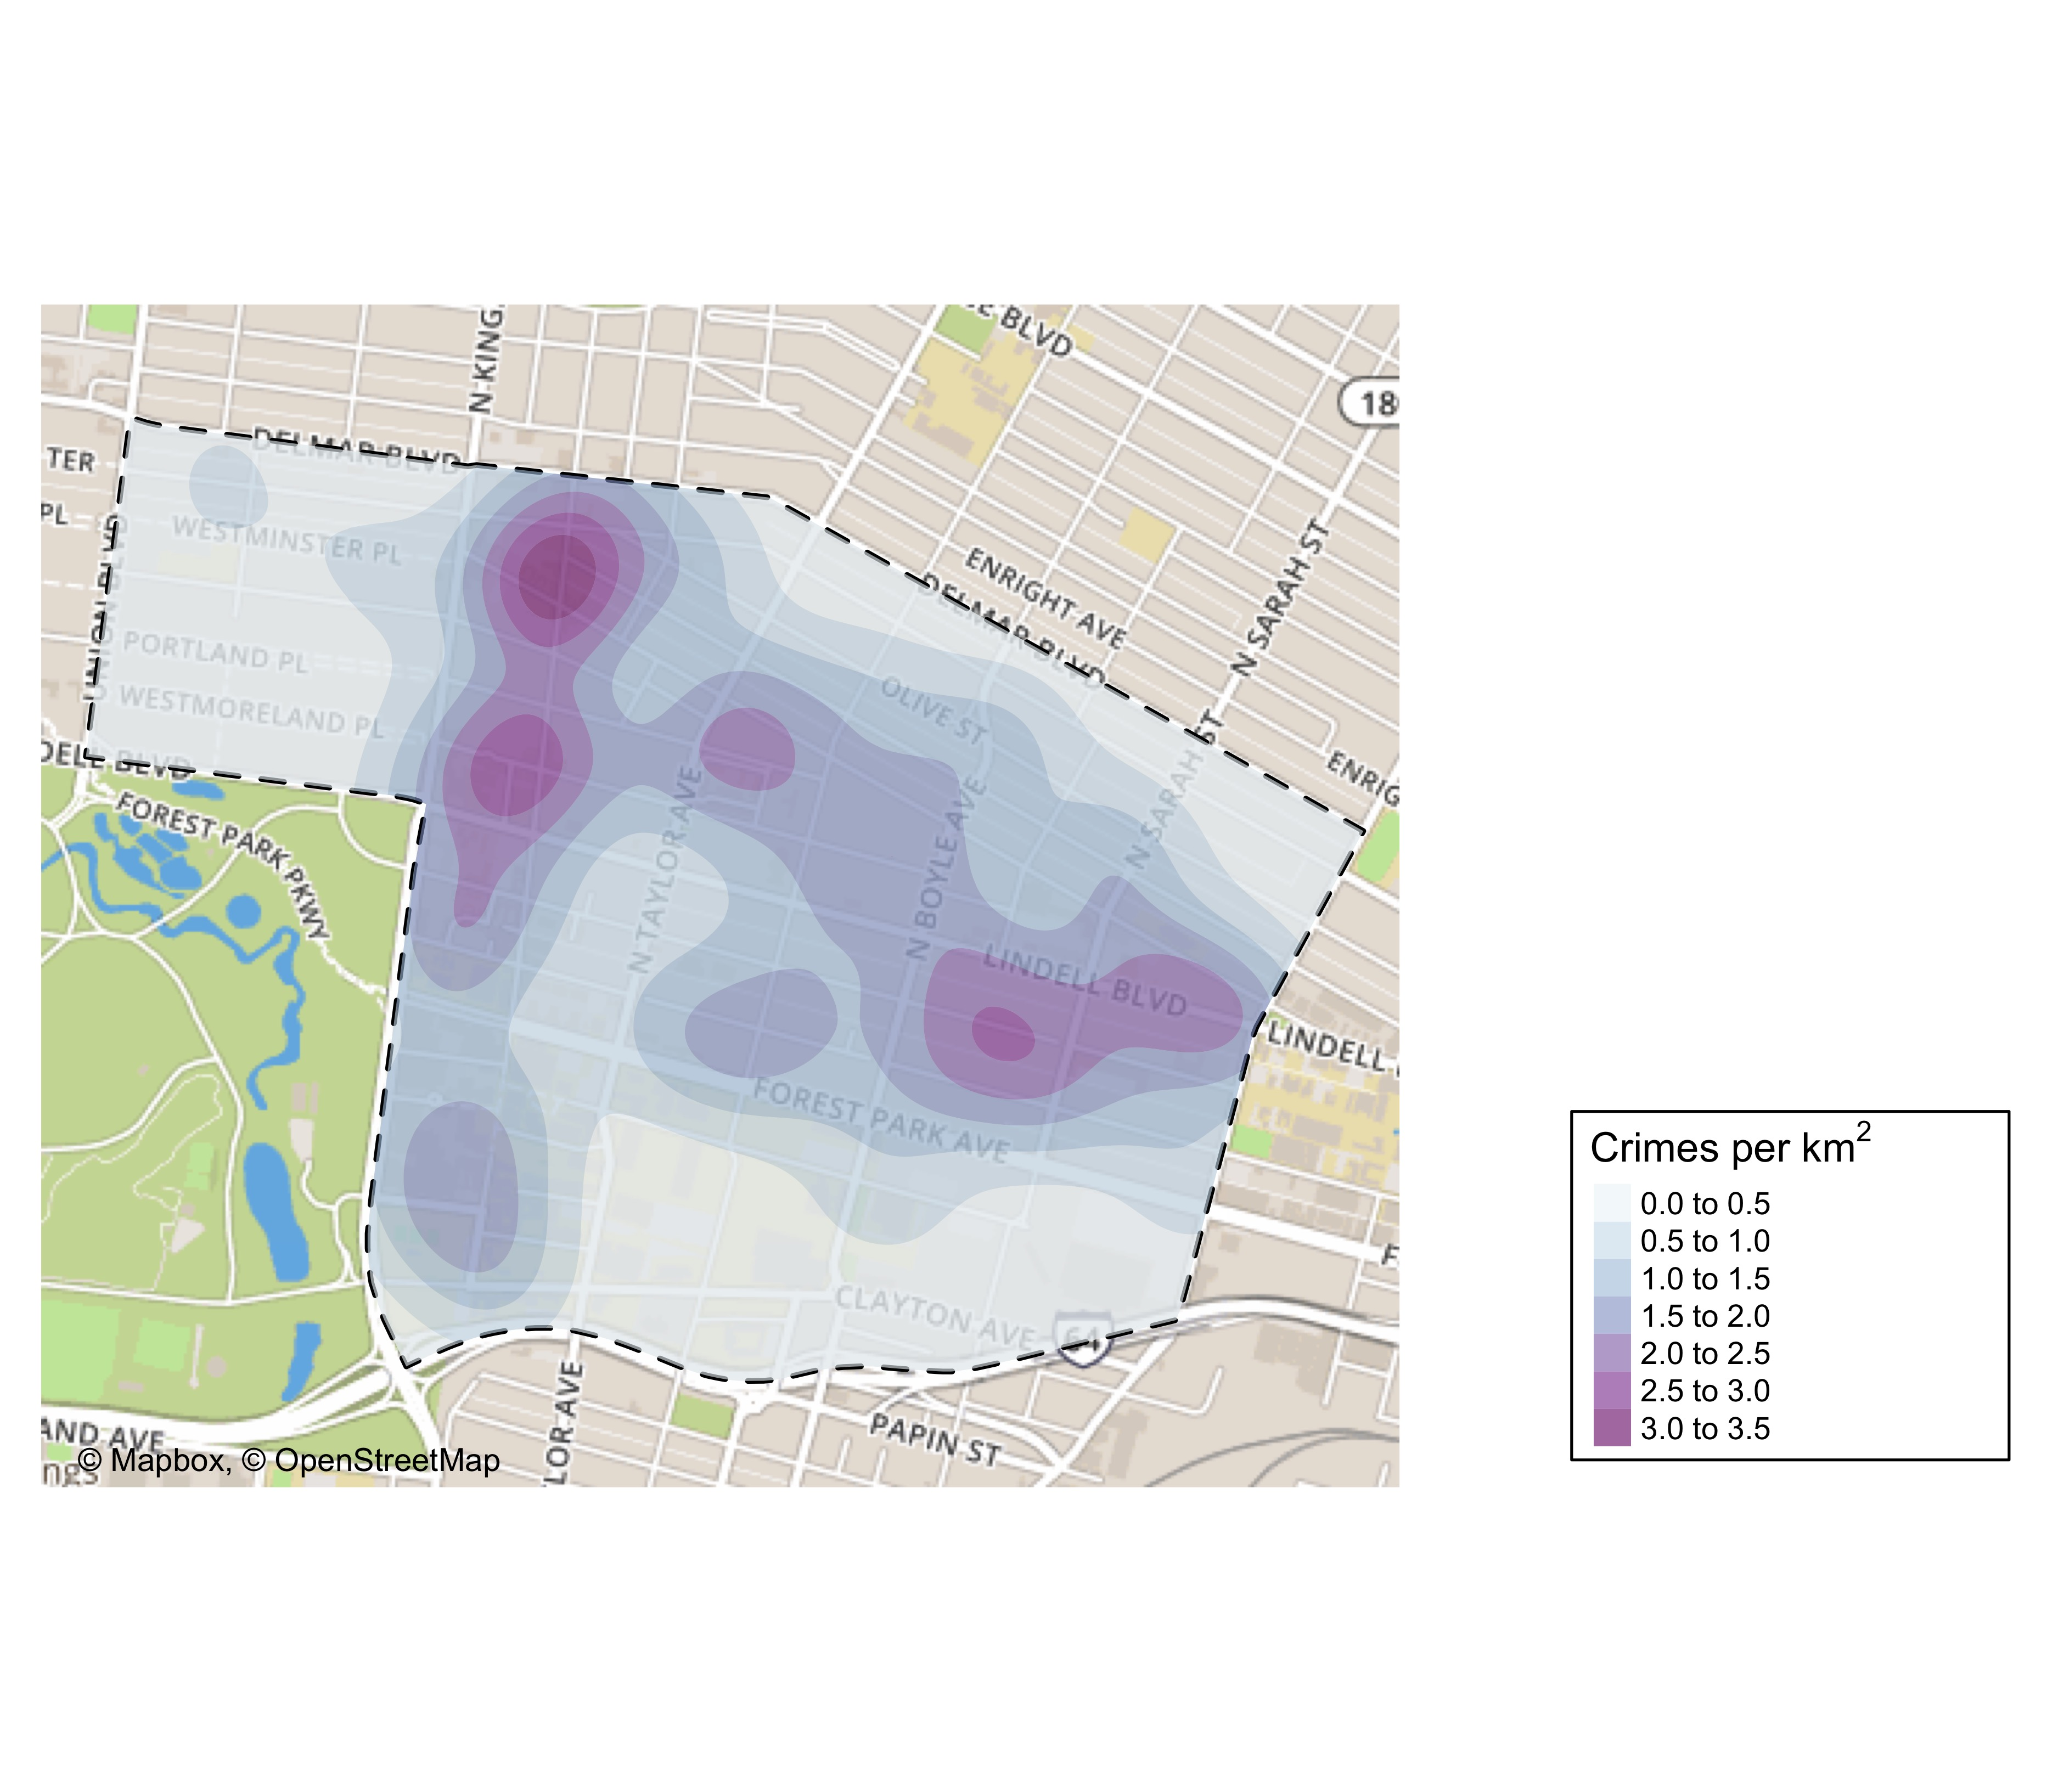
Central West End: Crime Density Map

Slide 37
Central West End: Larceny Breakdown
Day of the Week | Number of Crimes
Sun | 6
Mon | 11
Tue | 7
Wed | 13
Thu | 11
Fri | 19
Sat | 9
Total | 76
Time of Day | Number of Crimes
Day | 66
Night | 10
Total | 76
Type of Larceny | Number of Crimes
All Other | 7
Bicycle | 5
From Building | 14
From Motor Vehicle | 29
From Person | 1
Motor Vehicle Parts | 12
Shoplifting | 8
Total | 76
Monetary Value | Number of Crimes
$500 - $24,999 | 22
Over $25,000 | 1
Under $500 | 53
Total | 76

Slide 38
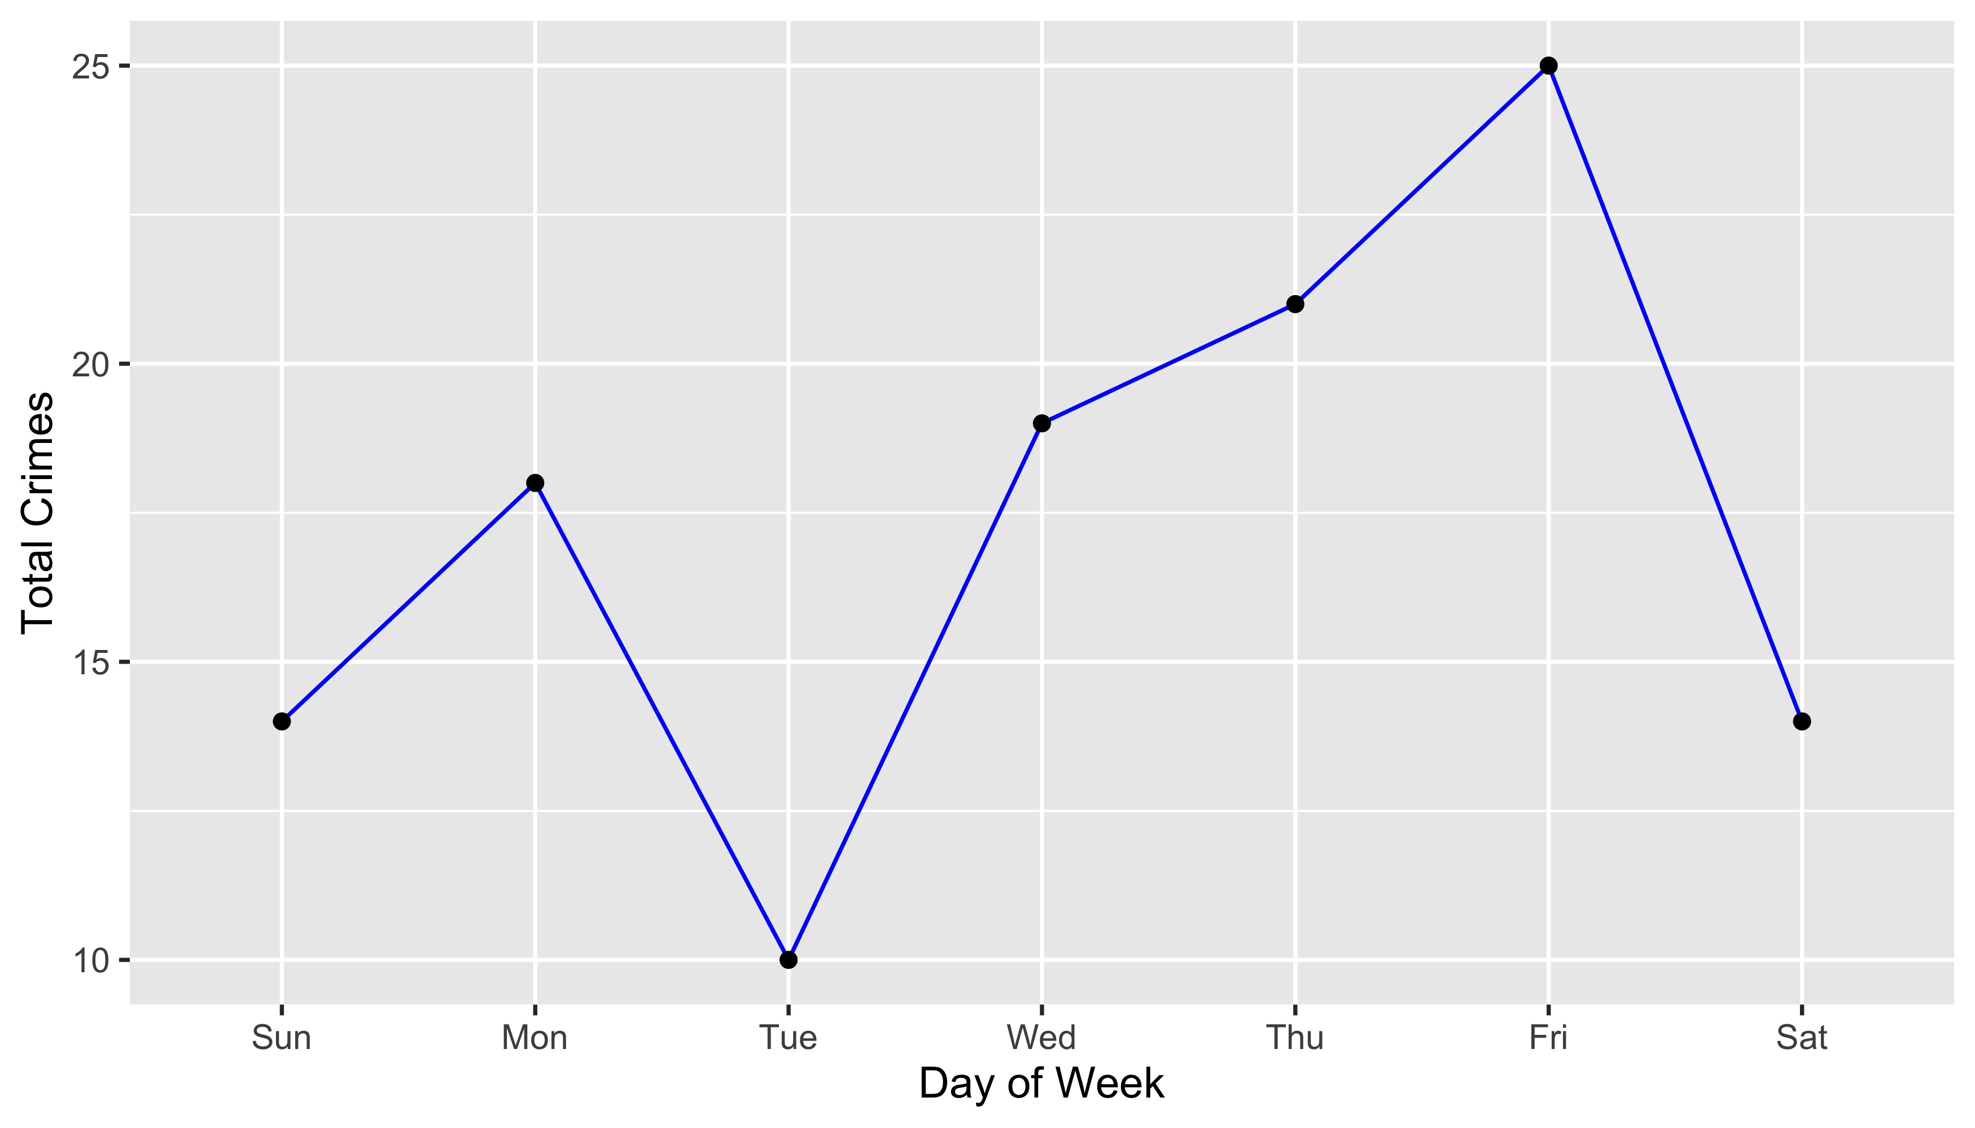
Central West End: Total Crimes by Days of the Week

Slide 39
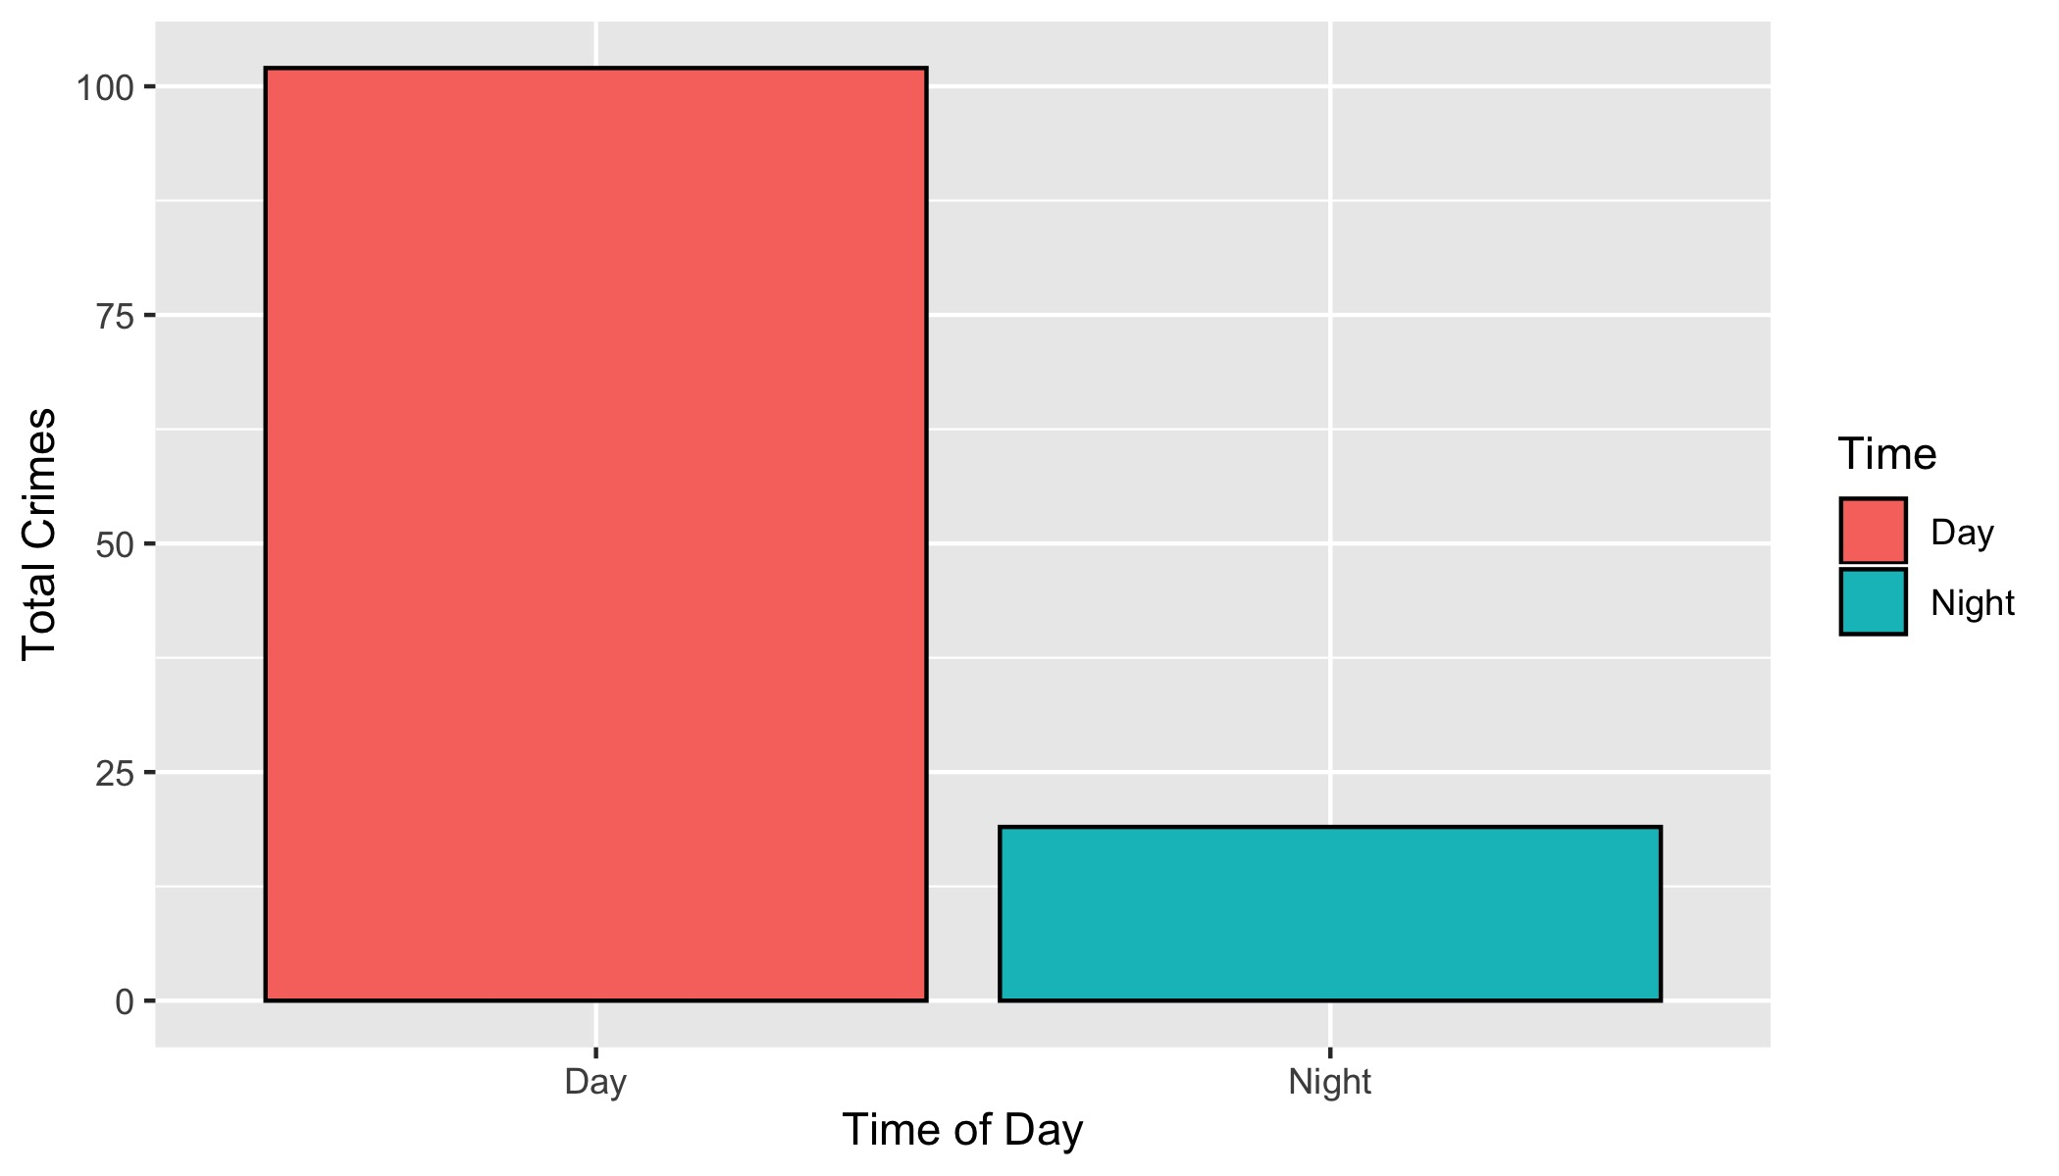
Central West End: Crimes by Time of Day

Slide 40
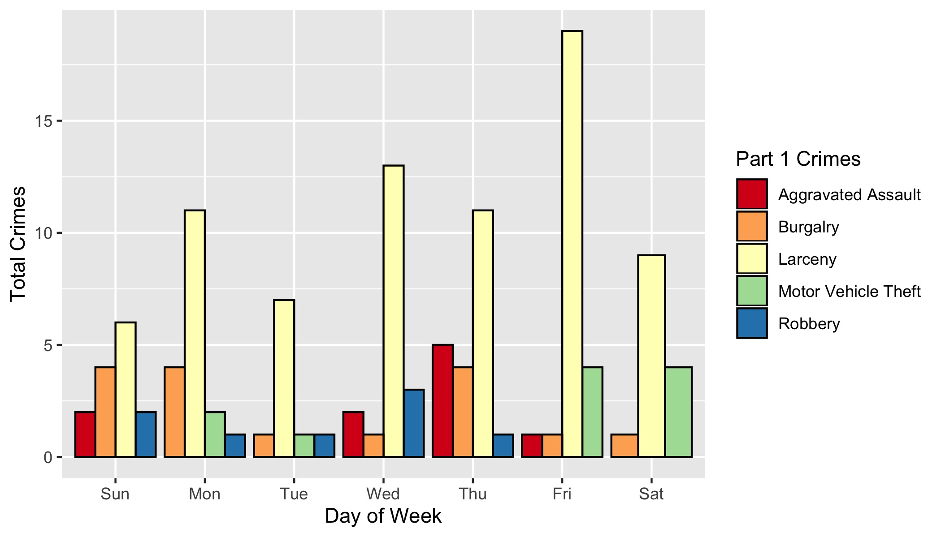
Central West End: Crimes by Day & Category

